Slide 1

Washington Food Coalition
Role and Trends
January 19, 2023

Slide 2
WHO IS THE WFC?
The Washington Food Coalition (WFC) actively educates and networks with organizations that strive to alleviate hunger throughout Washington.
Statewide membership coalition of 350 hunger relief agencies – food banks, food pantries, meal programs & other partners.
Twenty board members, made up of coalition members from our 14 districts. Plus, an executive committee and At-Large members.

Slide 3
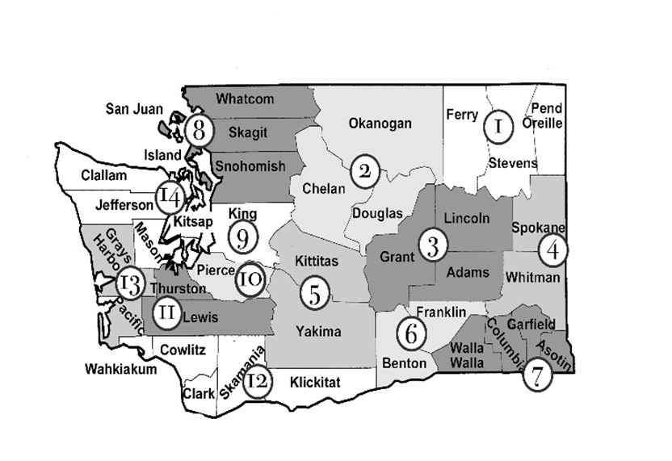
WHO IS THE WFC?
Funding:
Contract with WSDA – Food Assistance Programs
Contract with Labor & Industries
Membership dues
Conference Sponsorships
Staff: Executive Director, two independent contractors working on nutrition and food safety projects.

Slide 4
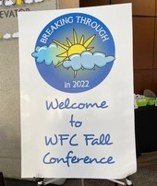
Role of the Washington Food Coalition
WFC works to strengthen the emergency food system through:
Providing technical assistance and guidance to food programs on a variety of subjects.
On call assistance
A yearly 3-day conference with training and networking opportunities
Food Bank Certification Course (on-line)
On demand access to the Nonprofit Safety Hero Program including Safety Leadership, Ergonomics, Tools & Equipment, and Safe Buildings, Safe Volunteer guide, and the Accident Prevention Program.
Providing Resource Manuals & other resources.
Notes:
Food safety, nonprofit management, food banking, volunteer management and forms.
Resource manuals on food safety, SDN, Food banking and best practices

Slide 5
Role of the Washington Food Coalition
Health Centered Food Banking Project
Get Certified Project – CFPM
Advocate and educate for funding for hunger relief organizations at the State level.
Weekly, monthly and quarterly newsletters.
Adapt our efforts to make sure our members receive the most out of their membership and ensure no one in Washington goes hungry.

Slide 6
Current trends
Things are crazy!
Service numbers are higher in some areas then during the Pandemic. Nearly 1 in 11 Washington households still struggle to put food on the table.
According to Feeding America, more than 34 million people in the U.S., including about 9 million children, experience food insecurity.
The Center for Disease Control and Prevention found that food insecurity is associated with a 257 percent higher risk of anxiety and a 253 percent higher risk of depression.
The main challenge is that there’s less food in the system or available to order from partners like FLL, NWH, or 2nd Harvest.
Food costs are still high for some of the most desirable foods (eggs, dairy, meats). 12% increase in the past year. (USDA)
Food prices, supply chain disruptions, and a shortage of labor and a decreased availability of donated food, and the same amount of people to serve - is a huge challenge.
Notes:
4. so even if a hunger relief org has a budget to purchase something from a private retailer, the dollars are generally not stretching as far as they have in the past.

Slide 7
The promising news is that USDA is rolling out lots of support through several federal program such as TEFAP.
WSDA just placed an order of food valued at $1.8 M that will be available to programs later this month and in early February.
WSDA will be purchasing more foods (another $3M) delivered in around March-April.
Notes:
As things get more expensive for both clients and hunger relief organizations, the demand increases on the resources available. Meaning clients can afford to buy less out of pocket, so need more from a food pantry, but the food pantry is also having a hard time getting all the food necessary for well-rounded and generous distributions.

Slide 8
What can you do to get involved?
Hunger Action Day, February 7th Hybrid event
This is an important lobbying day for food justice advocates to meet with representatives and encourage them to take meaningful policy action to address the root causes of hunger in Washington state. You’ll be able to participate in-person or virtually.
^{To register, link here.}
Support Washington’s Food Banks
Increased support to help food banks afford staffing, food purchases, and equipment help keep our doors open for business
We hope our legislative proposal will be successful and that would allow us to continue providing stabilizing resources to the system in 2023-2025.
Donate to your local food pantry/food bank.

Slide 9
Questions
Trish Twomey
trish@wafoodcoalition.org
206-669-1740

