Slide 1
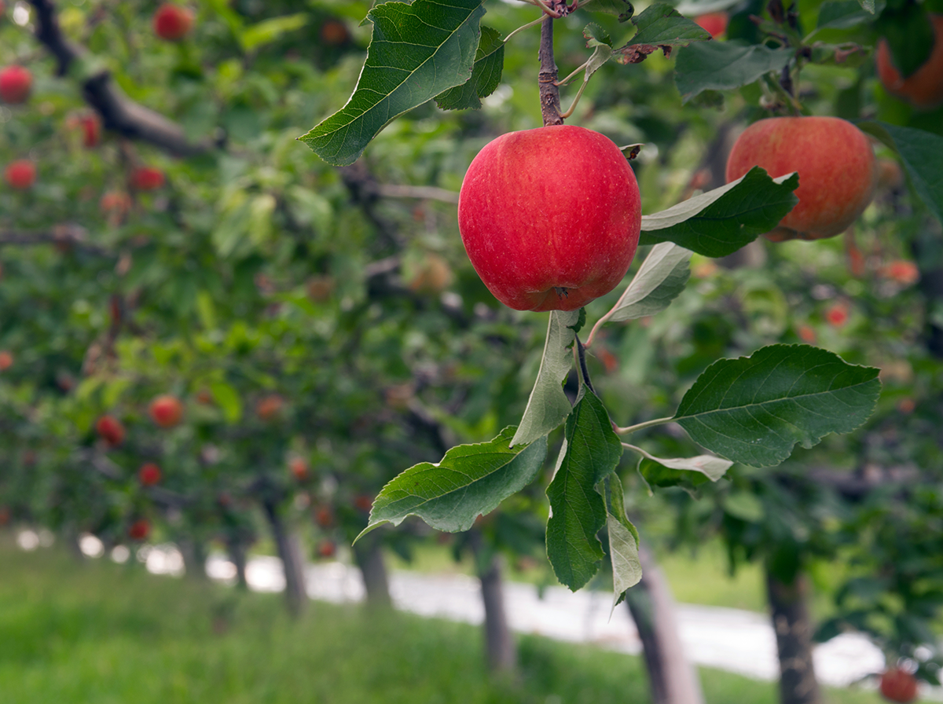
Introduction to the Washington Food Policy Forum
October 2022
Notes:
Join our listserv!
https://public.govdelivery.com/accounts/WASCC/subscriber/new?topic_id=WASCC_66

Slide 2
Food Policy Forum Member Organizations | Organization | Organization
Food Lifeline | WA State Farmers Market Association | Tilth Alliance
American Farmland Trust | WA State Dairy Federation | WA State Legislature
Washington State Department of Health | WA Department of Agriculture | WA Farmland Trust
Thurston Economic Development Council | WA Association of Wheat Growers | Charlie’s Produce
Washington State Department of Social and Health Services | Clark County Food System Council | Conlin Columbia Partnership for Cities
LINC Foods | WA Tree Fruit Association | Thread Fund
Initiative for Rural Innovation and Stewardship | WA State Legislature | WA Association of Conservation Districts
Washington State University - CSANR | WA Office of Superintendent of Public Instruction | WA Food Coalition
Washington State Potato Commission | Snohomish County | WA State Legislature
Whatcom County Public Works | Washington State University | WA State Farm Bureau
WA State Conservation Commission | Food Northwest | WA Young Farmers Coalition
Northwest Harvest | Washington State Legislature | WA Association of Land Trusts
WA State Anti-Hunger and Nutrition Coalition | King Conservation District
Notes:
Current membership includes representation from economic development, processing and distribution, anti-hunger and food accesses, elected officials, producers and more.

Slide 3
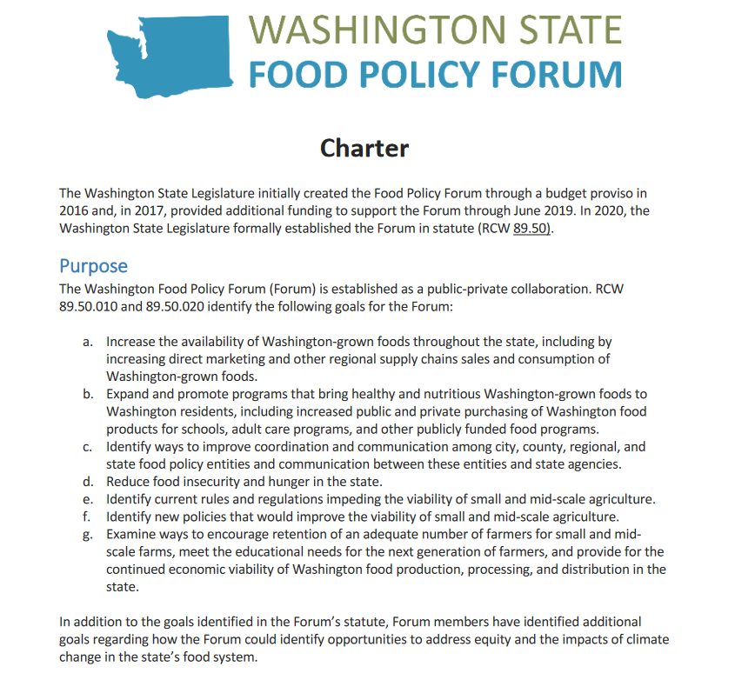
The Washington food policy forum is established as a public-private collaborative effort and its purpose is to advance the following food system goals:
The Forum was established in statute in 2020 after being initially created through a budget proviso in 2016. The Forum finalized its charter in summer 2022.
Increase the availability of Washington-grown foods throughout the state, including by increasing direct marketing and other regional supply chains sales and consumption of Washington-grown foods.
Expand and promote programs that bring healthy and nutritious Washington-grown foods to Washington residents, including increased public and private purchasing of Washington food products for schools, adult care programs, and other publicly funded food programs.
Identify ways to improve coordination and communication among city, county, regional, and state food policy entities and communication between these entities and state agencies.
Notes:
The Washington State Department of Agriculture (WSDA) and the Office of Farmland Preservation (OFP) work in partnership with SCC to convene and manage the Forum. Ross Strategic is contracted by SCC to provide facilitation support.
The Forum finalized its charter this summer.

Slide 4
Forum Goals Cont.
Reduce food insecurity and hunger in the state.
Identify current rules and regulations impeding the viability of small and mid-scale agriculture.
Identify new policies that would improve the viability of small and mid-scale agriculture.
Examine ways to encourage retention of an adequate number of farmers for small and mid-scale farms, meet the educational needs for the next generation of farmers, and provide for the continued economic viability of Washington food production, processing, and distribution in the state.
In addition to the goals identified in the Forum’s statute, Forum members have identified additional goals regarding how the Forum could identify opportunities to address equity and the impacts of climate change in the state’s food system.

Slide 5





The Forum’s Systems Lens
Through a three-part process beginning in January 2018 the Forum defined which aspects of the food system to focus on.
301 Level
The Forum launched teams to make recommendations in five areas of the food system.
The greatest and most effective progress will come from moving multiple food system changes forward in tandem so that systems change can occur
101 Level
Food systems experts introduced the Forum to a variety of food system issues and initial recommendation ideas were identified.
Infrastructure and Rural Economic Development
Food Insecurity
201 Level
Impacts of Climate Change
Food systems experts offered in-depth discussion and proposed recommendations for the following seven topics that were collectively prioritized by the Forum
Agricultural Land Protection and Availability and Next Generation Farming
Alleviating Barriers to Small and Medium Scale Farmers Accessing Markets, Including Institutional Purchasing

Slide 6
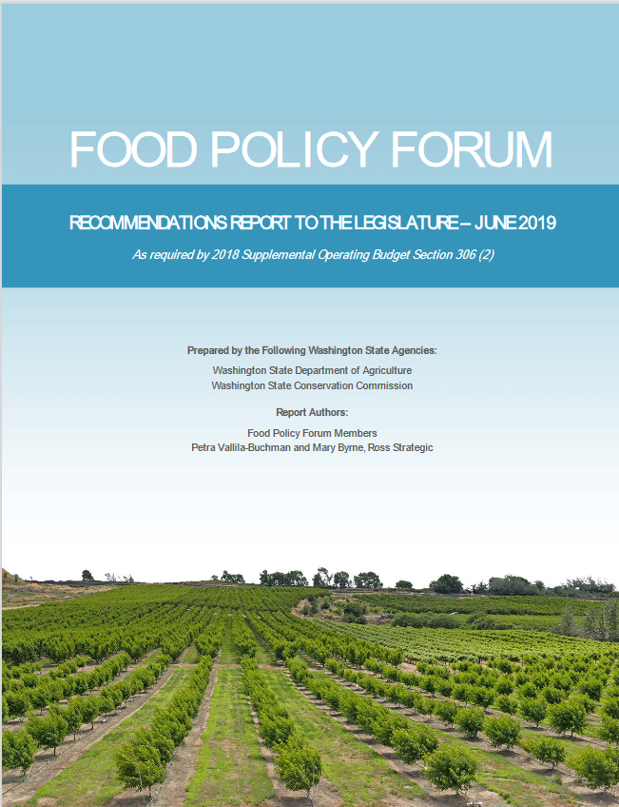
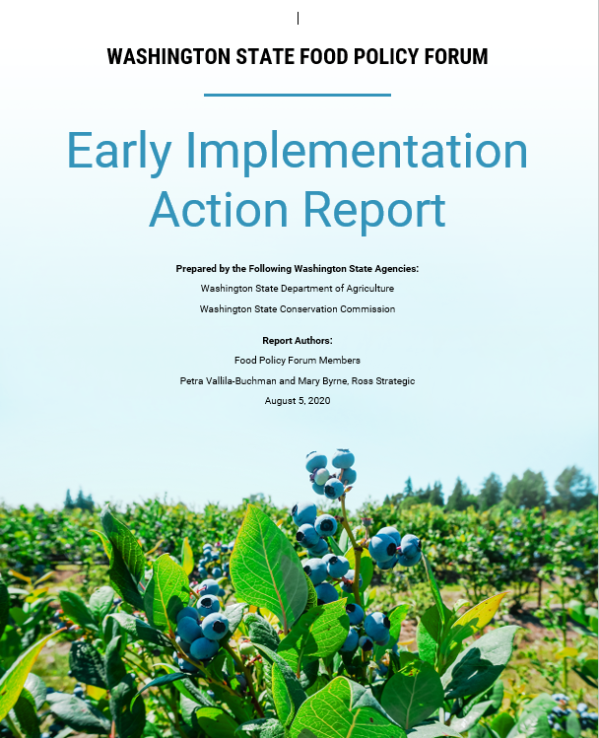
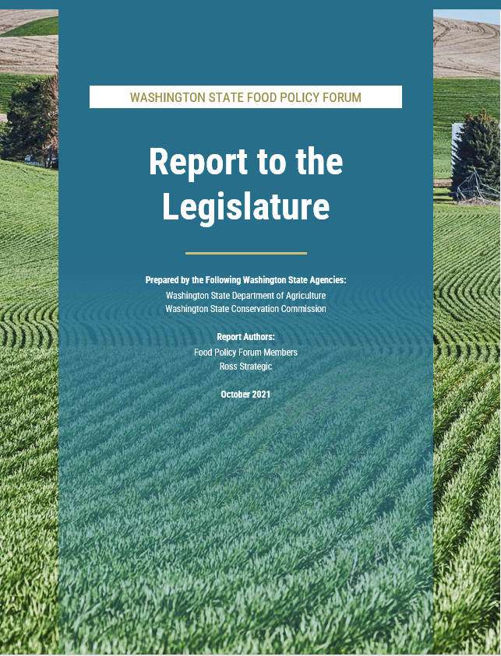
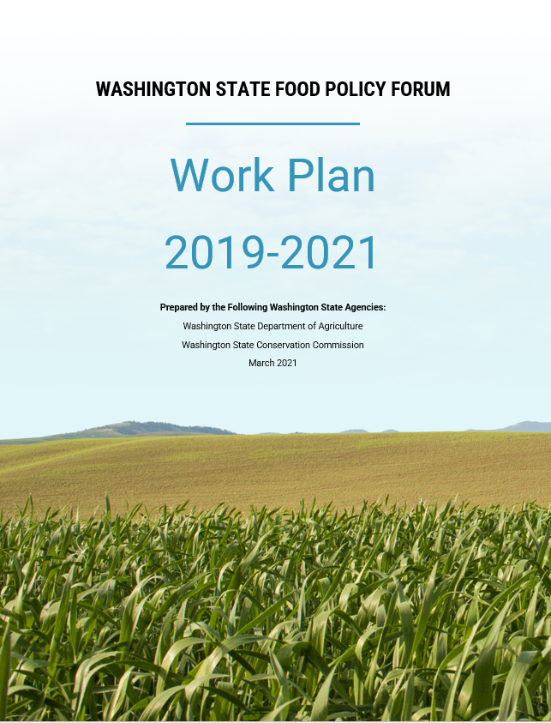
Rapidly identified 50+ early implementation actions in light of COVID-19 — March to June 2020
In October 2021, the Forum drew from its consensus recommendations to highlight a handful of recommendations that are particularly timely for legislative action.
June 2019: 50+ consensus recommendations
Integrating equity into how we work
Committed to identify how actions and recommendations of the Forum impact equitable outcomes for Washingtonians— August 2020​
Convened equity subcommittee to plan equity 101 — Fall 2020​
Hosted equity 101 meeting — December 2020​
Developed and tested a draft equity filter – Spring - Summer 2021
Used the filter to develop equity considerations – October 2021
Notes:
The Washington State Food Policy Forum (Forum) has been convening since 2016 to reflect on key challenges facing our state’s food system.
In 2019, the Forum came to consensus on 50+ recommendations for improving the food system.
The pandemic revealed or amplified food system vulnerabilities in four key issue areas, all of which have been topics of discussion at the Forum. Drawing from the 2019 consensus recommendations, in 2020 the Forum produced a second report and workplan which have a particular focus on the impacts and opportunities
presented by COVID-19.
For this third report, the Forum reflected on its prior consensus recommendations to produce a short list of recommendations that are particularly timely and relevant for action during the 2022 legislative session. The Forum then utilized its equity filter tool to explore ways the recommendations might be implemented for more equitable results; equity considerations for design and implementation of the recommendations are captured in the 2021 report.

Slide 7
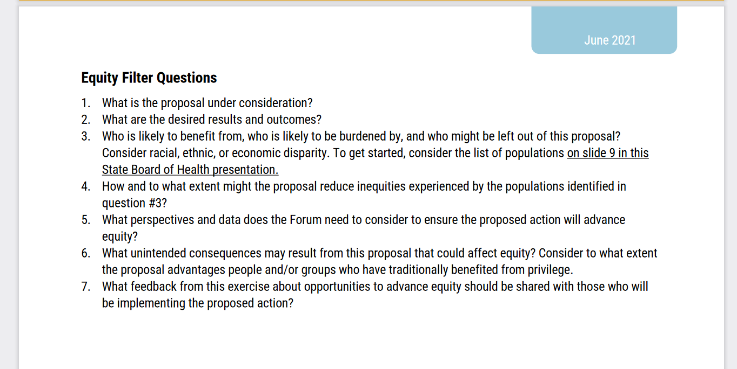
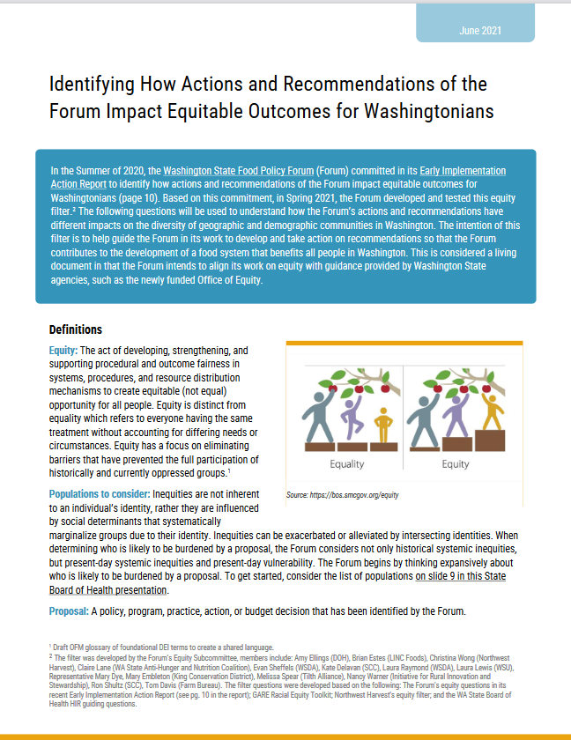
The Forum’s Equity Filter
The filter was developed by the Forum’s Equity Subcommittee, members include: Amy Ellings (DOH), Brian Estes (LINC Foods), Christina Wong (Northwest Harvest), Claire Lane (WA State Anti-Hunger and Nutrition Coalition), Evan Sheffels (WSDA), Kate Delavan (SCC), Laura Raymond (WSDA), Laura Lewis (WSU), Representative Mary Dye, Mary Embleton (King Conservation District), Melissa Spear (Tilth Alliance), Nancy Warner (Initiative for Rural Innovation and Stewardship), Ron Shultz (SCC), Tom Davis (Farm Bureau).
Notes:
Spring 2021- the Forum developed and tested an equity filter to understand how the Forum’s actions and recommendations have different impacts on the diversity of geographic and demographic communities in Washington.
The filter questions were developed based on the following: The Forum's equity questions in its recent Early Implementation Action Report (see pg. 10 in the report); GARE Racial Equity Toolkit; Northwest Harvest’s equity filter; and the WA State Board of Health HIR guiding questions.
Link to equity filter on SCC website: https://uploads-ssl.webflow.com/5faf8a950cdaa224e61edad9/60e4ddcd3334f1ebe12e7e9d_FPF%20Equity%20Filter_June%202021.pdf
State Board of Health presentation: https://uploads-ssl.webflow.com/5faf8a950cdaa224e61edad9/5fd9537922225408d41b8822_HIR%2BEquityoverview_FoodPolicyForum_2020_FINAL.pdf

Slide 8
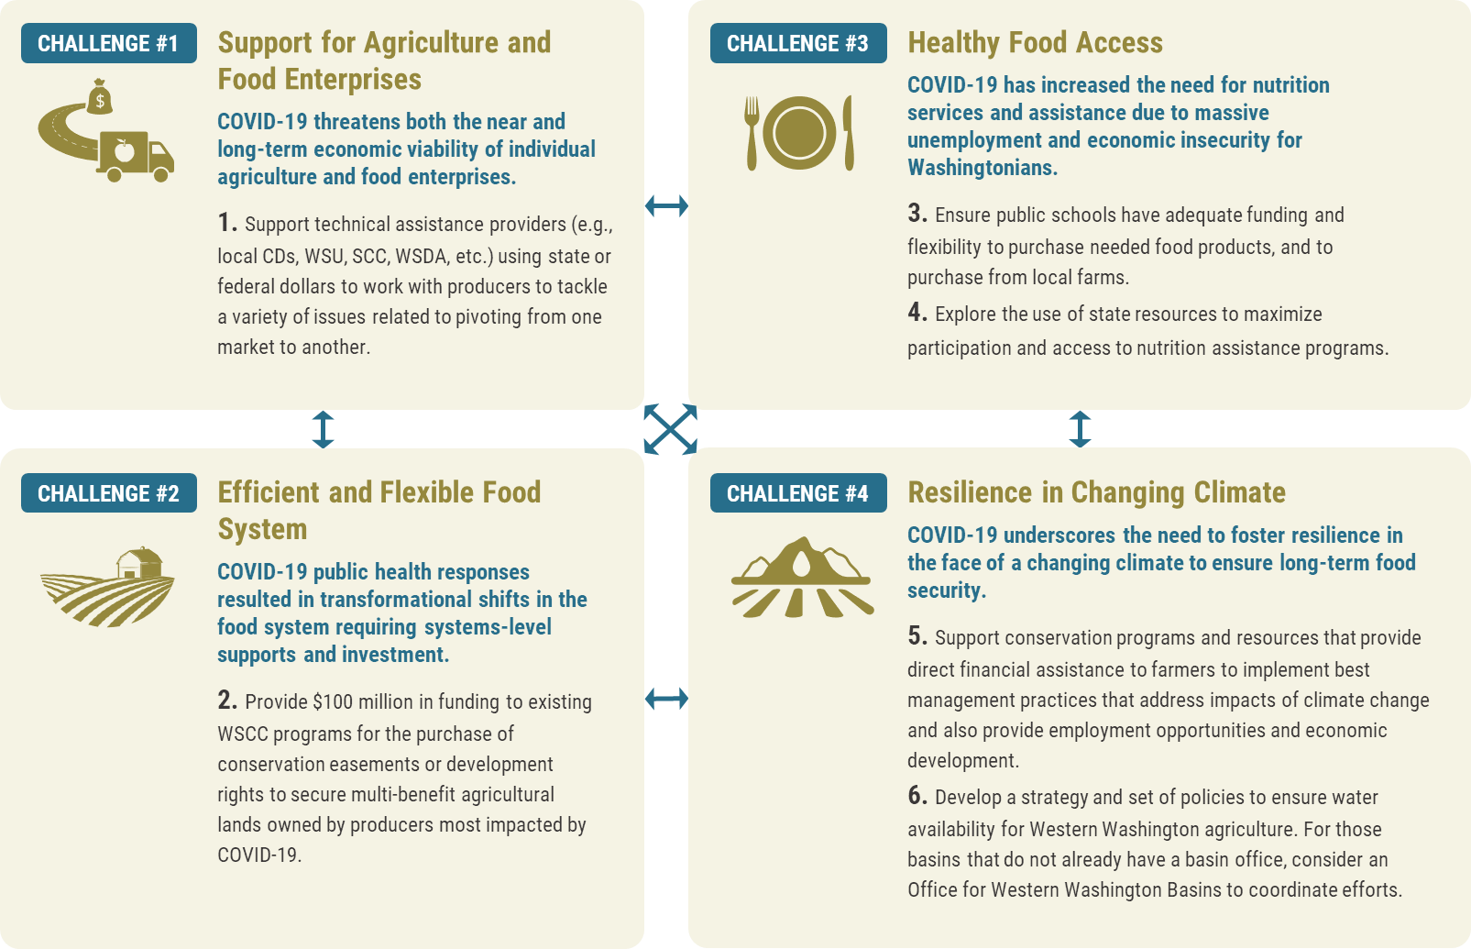
Equity Filter in Practice
Equity Consideration Examples
Maximize the reach of technical assistance by including a networking and education component to reach
diverse growers.
Latino farmers are the fastest growing population of producers in Washington State. An effective program should consider multilingual and multicultural outreach strategies to increase the chances that all producers learn about the program.
The fiscal note needs to adequately compensate community stakeholders who participate in program design for their expertise and time.
Consider if the program has gone through initial climate risk assessment, a process that can help inform the geographic location of farm communities who will be vulnerable to the impacts of climate change (whether that be flood, drought, rising sea level, or other climate change impacts).
The creation of a program like this should incorporate enough flexibility to be able to account for learning
that will take place throughout program creation; this learning should involve people who may be
experiencing food insecurity so they can help design solutions that meet their needs.
In October 2021, the Forum drew from its consensus recommendations to highlight a handful of recommendations that are particularly timely for legislative action.

Slide 9
Current Phase of Work
Dec. 2021
Identified important topics that warrant the Forum's attention within the six topic areas identified in the Forum’s 2019 report.
Jan. 2022
Discussed the December Forum brainstorm and determine what actions the Forum can take to move those ideas along.
Weighed in on topic/action pairings that are ready to move.
Feb. 2022
Teams presented ideas for how the Forum can take different kinds of action in 2022 to support food system change.
Three topics were prioritized.
Teams discussed with each other the ideas and signed up to support moving the actions forward.
March 2022 onward
Teams have been meeting and taking action.
1.State Brand and Marketing
2. Farm Bill 2023 Coordination
2. Informing Land Use Policy

Slide 10
Progress of 2022 Action Teams to date
State Band and Marketing
- Hosted a Learning Meeting with members, local Washington brands and PA Preferred brand staff.
- Developed of Context Document.
- Requested WSDA to submit a Decision Package for funding to scope and launch a program.
Informing Land Use Policy
- Hosted an August listening session on Patterns and Drivers of Agricultural Land Loss in Washington.
- Developed a series of 11 recommendations for Forum consideration related to policy solutions to stem agricultural land loss.
Farm Bill 2023
- Hosted Farm Bill Summit in October, where stakeholders shared data related to how the Farm Bill Impacts Washingtonians as well as drew connections to consensus recommendations of the Forum.

