Slide 1
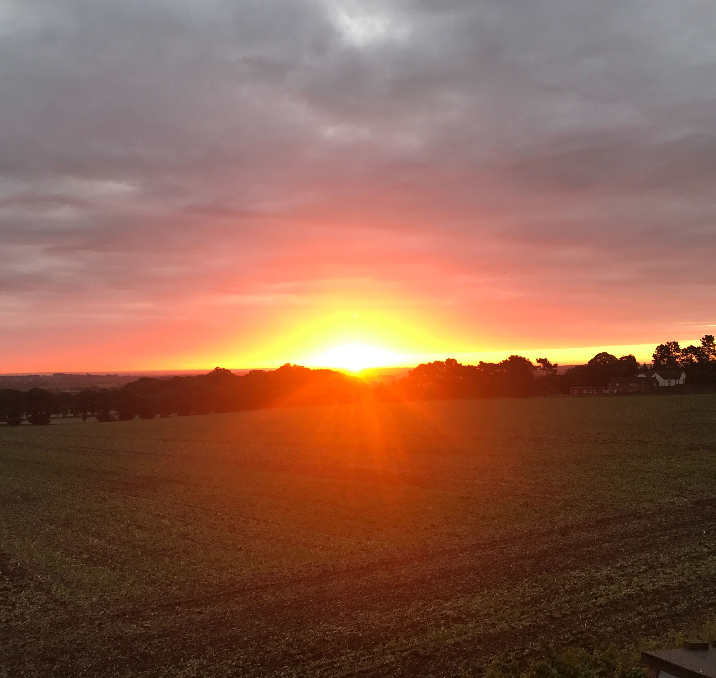
AgWest Farm Credit
Western Washington Food Systems Partnership
Lunch and Learn
October 18, 2023

Slide 2
Objectives for Today
Who is AgWest Farm Credit?
What AgWest FC loan programs are available?
How does AgWest Farm Credit help young, beginning, and small ag producers?
2

Slide 3

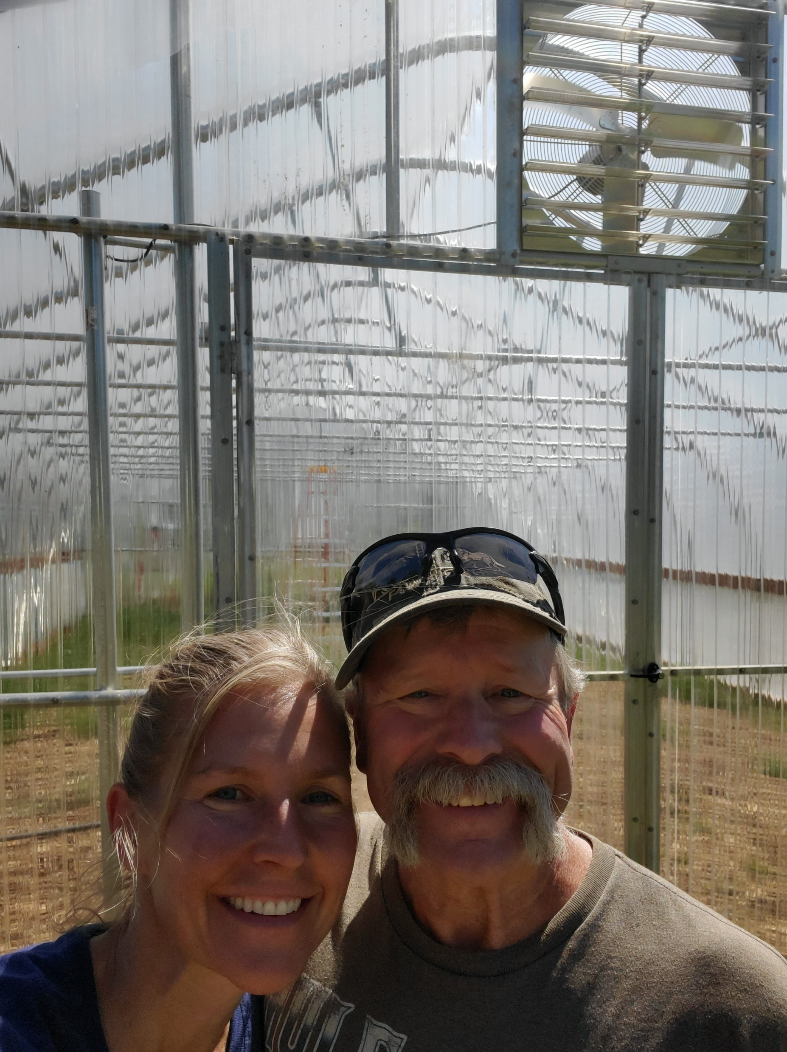
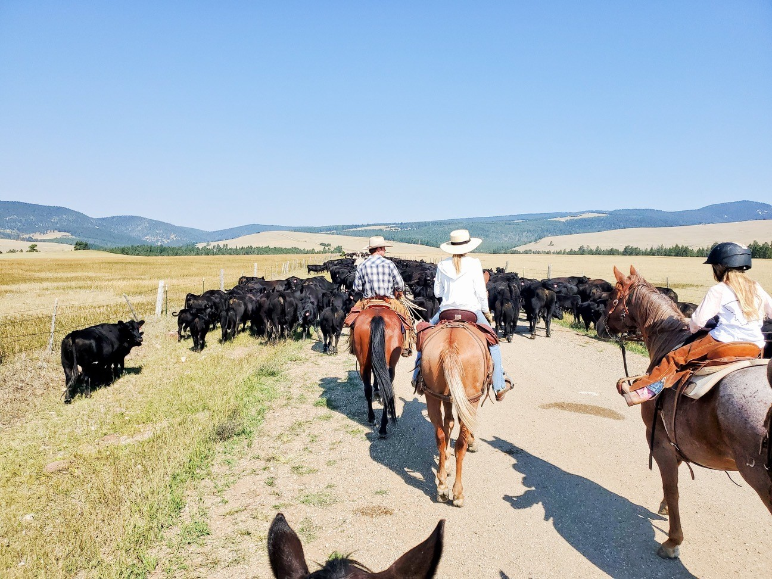
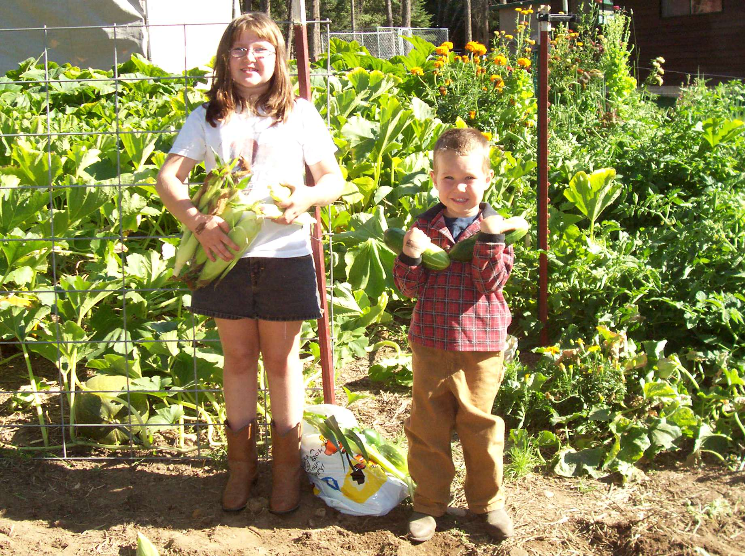
Small Family Farm Cherries and Peaches
College in Denver
Corporate Agribusiness ConAgra and Cargill
11 years at AgWest FC
Gallup-Certified Strengths Coach

Slide 4
Our Purpose
At AgWest Farm Credit, we champion agriculture by serving as the most trusted resource, helping our customers, employees and their communities thrive.

Slide 5
Grounded by tradition.
Inspired by possibility.
AgWest Farm Credit is an agricultural lending cooperative with more than a century of experience serving farmers, ranchers, timber harvesters, and aquatic producers throughout the West.
5

Slide 6
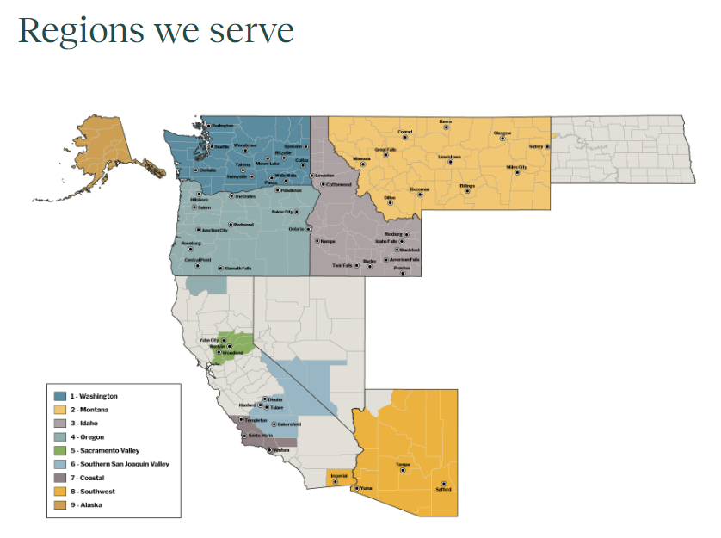
Online directory by county:
https://apps.fca.gov/FCSPublicDirectory/PubViewInst.aspx?u=725355

Slide 7
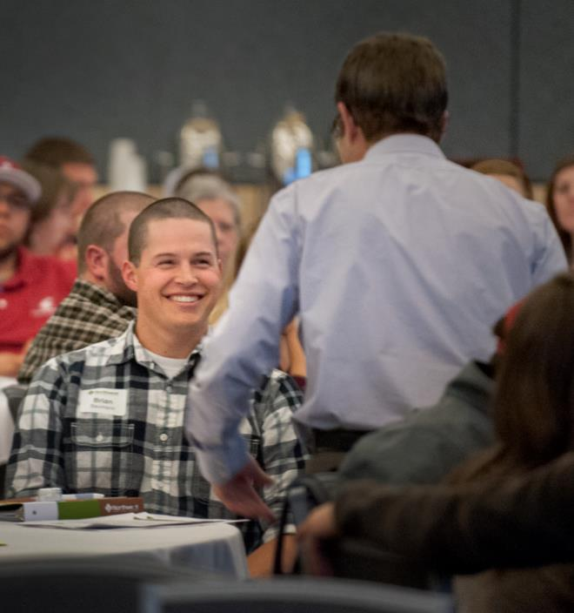
The Business Management Center (BMC)
EDUCATION
For Our Customer-members
Management education
Economic updates
Industry insights
Family business resources
Notes:
These learning opportunities are provided in-person as well as virtually. Visit AgWestFC.com to see recorded webinars and other materials.
https://agwestfc.com/education-and-resources/financial-tools/preparing-financial-statements

Slide 8

Our Stewardship Mission
PEOPLE FIRST
Rural Community Grants
Food Banks
Scholarships
Military Veteran Support
Youth Education
8
8
8
8

Slide 9
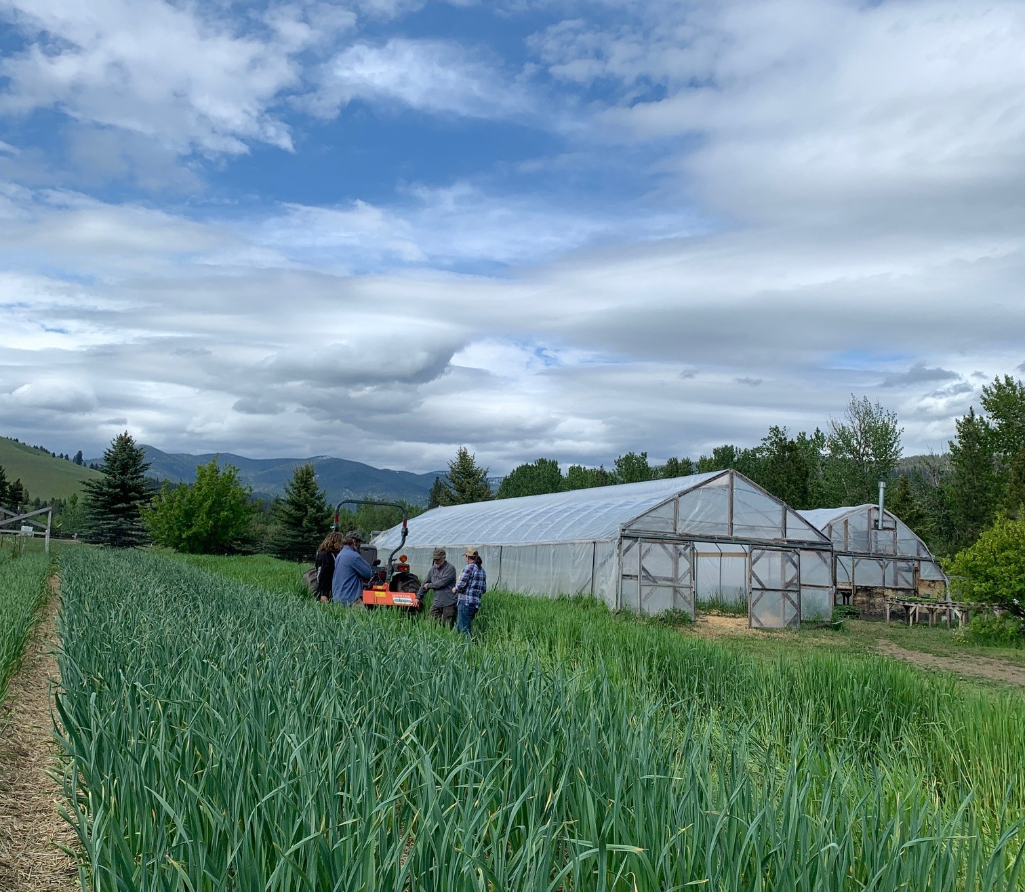
Young, Beginning or Small Producers
Specialized Program: AgVision
35 years old or younger
10 years or less experience in agriculture production
Annual gross agriculture income is less than $350,000
9

Slide 10
AgVision Program
Waived origination and appraisal fees
Specialized financing products
Reduced interest rates
Financial mentors
Flexible underwriting guidelines
Farm Service Agency – Preferred Lender
Management seminars
Education and technology expense reimbursement
RateWise – an education-based interest savings program
10

Slide 11
Types of Agriculture-Based Financing
Short-Term
Operating Lines
Intermediate-Term
Equipment, livestock, operational permits and rights, capital expenditures, and other capital needs
Long-Term
Real estate purchase, new facility construction, permanent crop development, and other capital needs
Country Home Loans

Slide 12





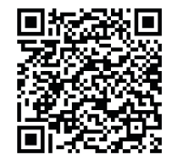
RateWise Program
An educational incentive program designed to help your operation thrive.
Earn credits for continuing education
Remit credits for interest rate reductions on new loans
Accumulate and use credits as long as you are a Young, Beginning, or Small producer
To learn more or register online, visit:
12

Slide 13
AgWest celebrates the ingenuity and passion of aspiring new producers
This program was developed for those who have a vision for their operation but may not be ready for traditional financing. Successful applicants will receive a one-time $15,000 grant to support the startup of their operation.
Through this program, AgWest is committing to:
Creating opportunities for new producers.
Providing support through educational resources.
Connecting, building relationships and inspiring others.

Slide 14
Funding projects that make a difference
Example projects eligible for the New Producer Grant:
Down payment for equipment, land, or fees to start an ag business
Equipment or inventory to produce or market a value-added agricultural product
Items to extend the growing season
Tools or materials to improve herd/flock health or increase pasture utilization
Irrigation components
Materials that build soil health
Annual farm operating expenses
Items that increase storage capacity, expand production or add distribution capacity
Equipment, supplies, or technology that will maximize efficiency and profitability

Slide 15
Eligibility
Eligible applicants need to meet the following requirements:
Be a full or part-time agriculturalist with two years or less of operational experience or plans to start their operation within two years of the grant application date.
Have an operation located within AgWest Farm Credit’s territory.
Not be a current AgWest lending customer.
Be 18 years of age.

Slide 16
Getting started in agriculture can be overwhelming. The application process for the New Producer Grant is designed to provide new entrants with financial and business educational resources to help them put their best foot forward.

Slide 17
Application requirements
Review the Strategic Business Planning guide on AgWestFC.com.
View three recorded webinars on AgWestFC.com covering financial statement basics.
Submit a business plan and cash flow budget.
Submit a one-page essay.
Next Grant Round: 2024

Slide 18
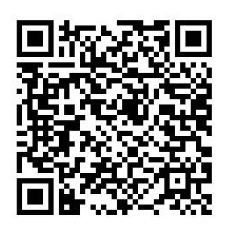
To learn more, visit
www.agwestfc.com or hear more about us on a recent Rocks to Roots podcast.
Questions?
Email: AgVision@AgWestFC.com

