Slide 1
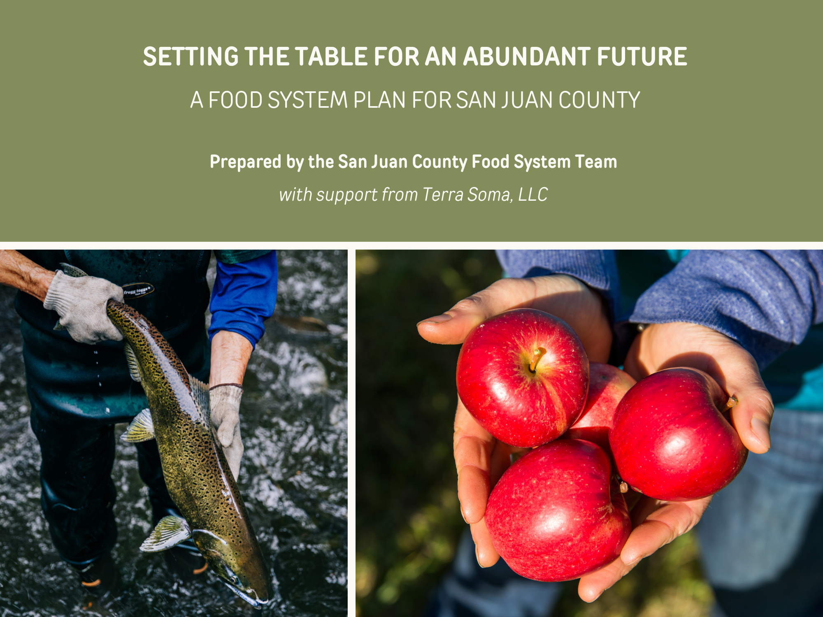

Slide 2
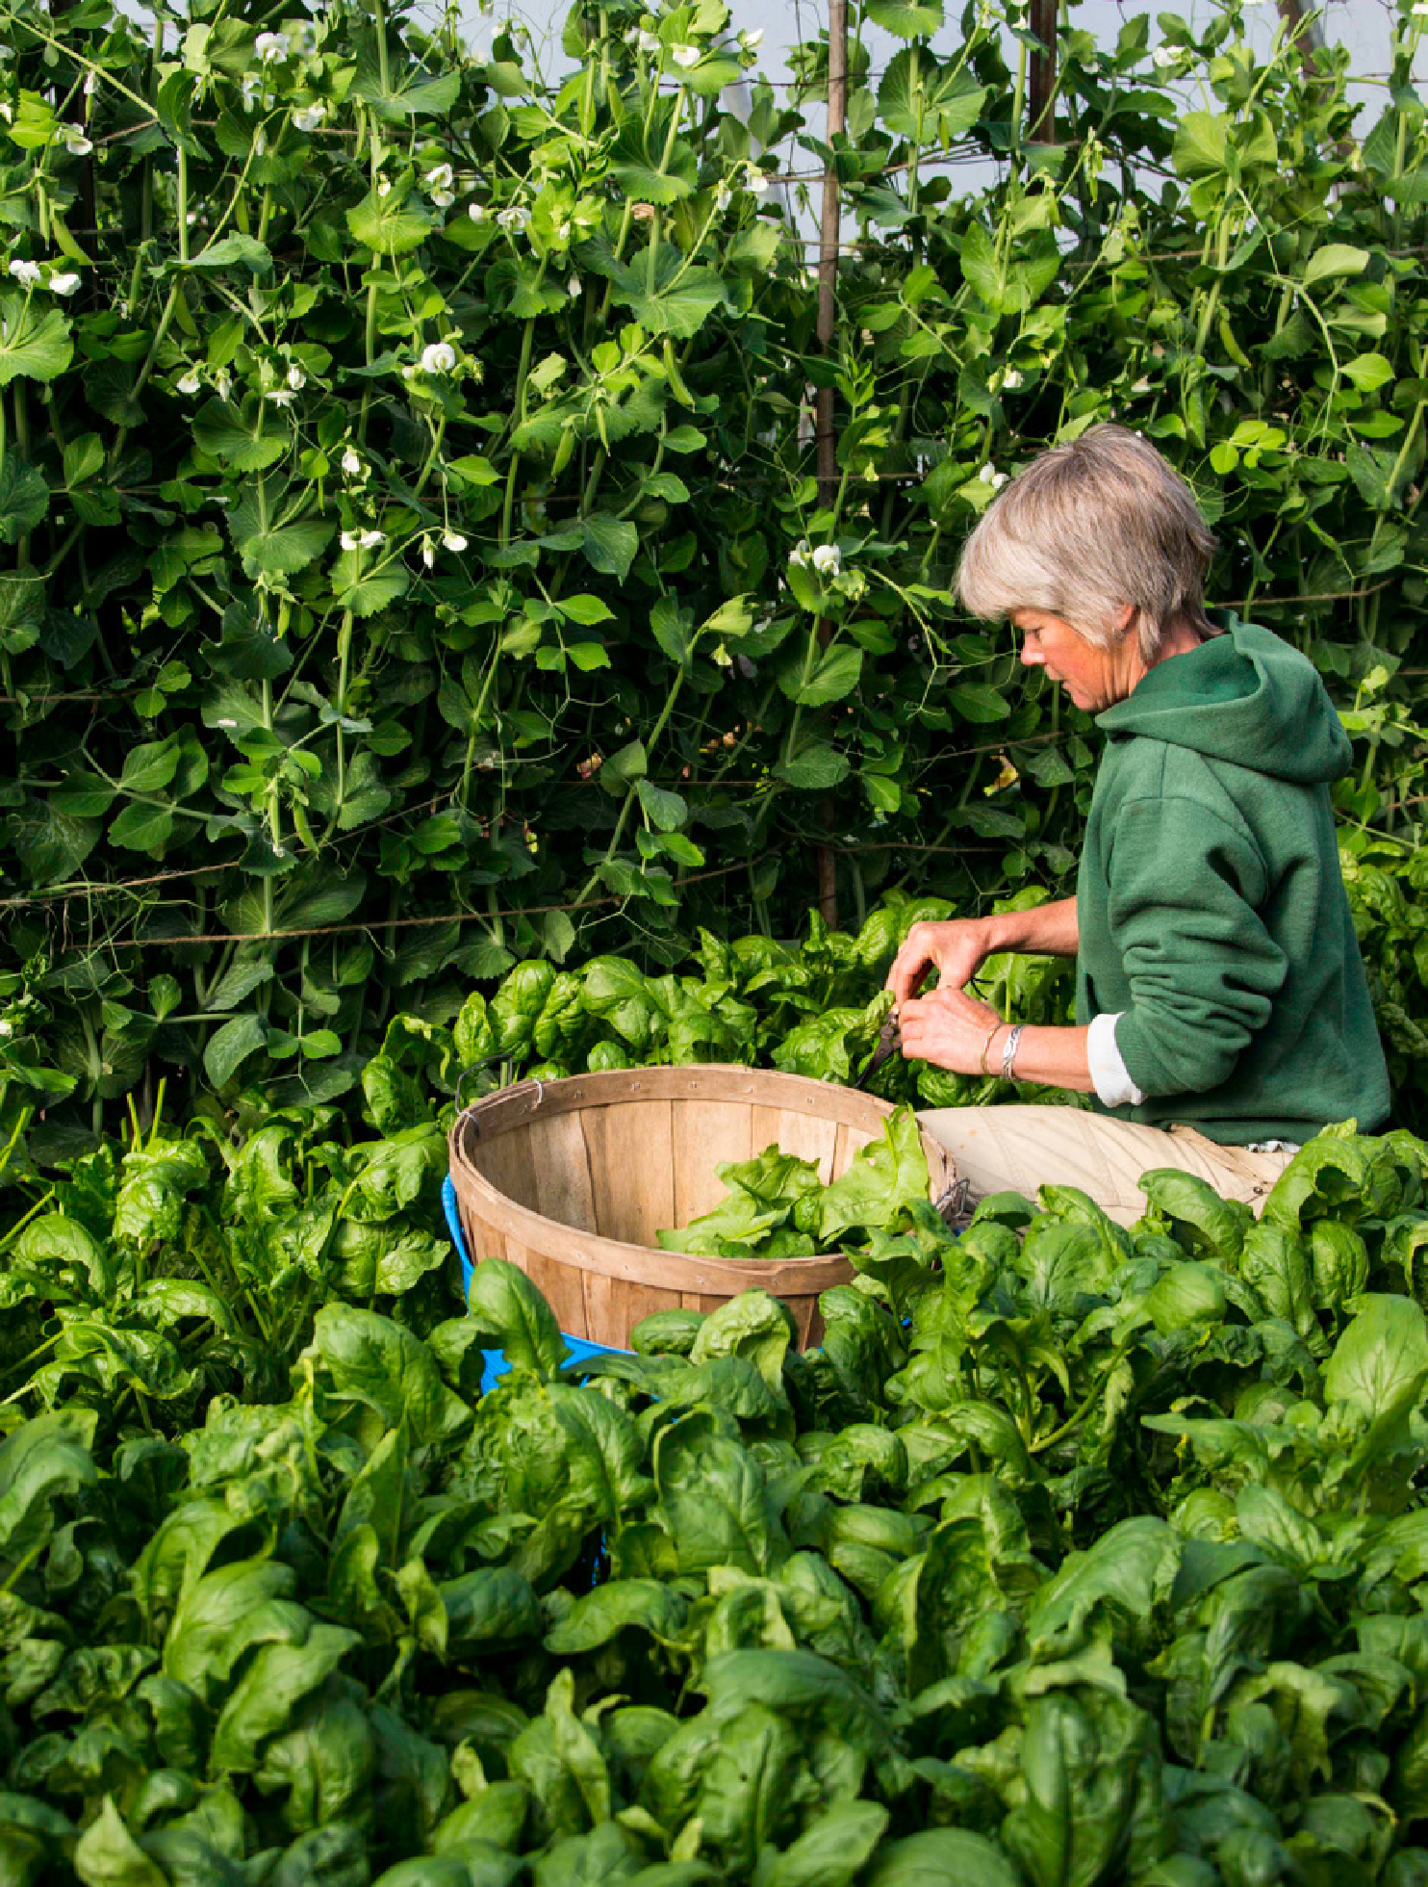
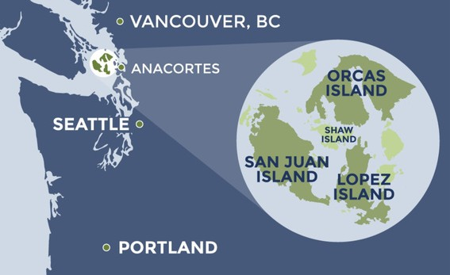
Presentation Overview
Maggi Adamek: Setting the Context
Caitlin Leck: Food System Plan Process
Learner Limbach: Measurement + Evaluation
Image: San Juan Islands Visitors Bureau
Image: Lopez Harvest Farm, by Summer Moon

Slide 3
What’s a food system plan?
A democratic process for designing a community’s food future
An evidence/best practices-based plan with goals and accompanying objectives, strategies, and change targets
A change agenda for food skills development, healthy food access, vibrant local food culture, food systems infrastructure improvements, and growth of and support for a thriving food and farm economy
Often responsive to climate and food security-related issues
A clear, comprehensive, long-term developmental path for a locale’s food and agricultural systems

Slide 4
What’s up with food systems plans?
Hundreds of cities worldwide have created food systems plan under an international pact
Geographies and organizations at all scales across the US are developing food systems plans to address a variety of food and farm-related issues
Many communities in Washington state have done so, including numerous areas in Western Washington
Island communities in the US are developing food systems plans to respond to their unique issues, geographies, vulnerabilities, and assets
…It’s all the rage…
….reskilling…
…relocalizing…
…restoring local and regional scales…
…ensuring equity…

Slide 5
How does a community implement a food systems plan?
Develop a process/infrastructure to plan for and support implementation
Prioritize strategies for each goal
Identify proven actions to achieve those strategies that also have local champions and available resources
Develop workplans and key stakeholders and secure resources to implement actions
Create systematic means for measuring and reporting progress and outcomes
Share progress and motivate participation through effective promotion and communications

Slide 6
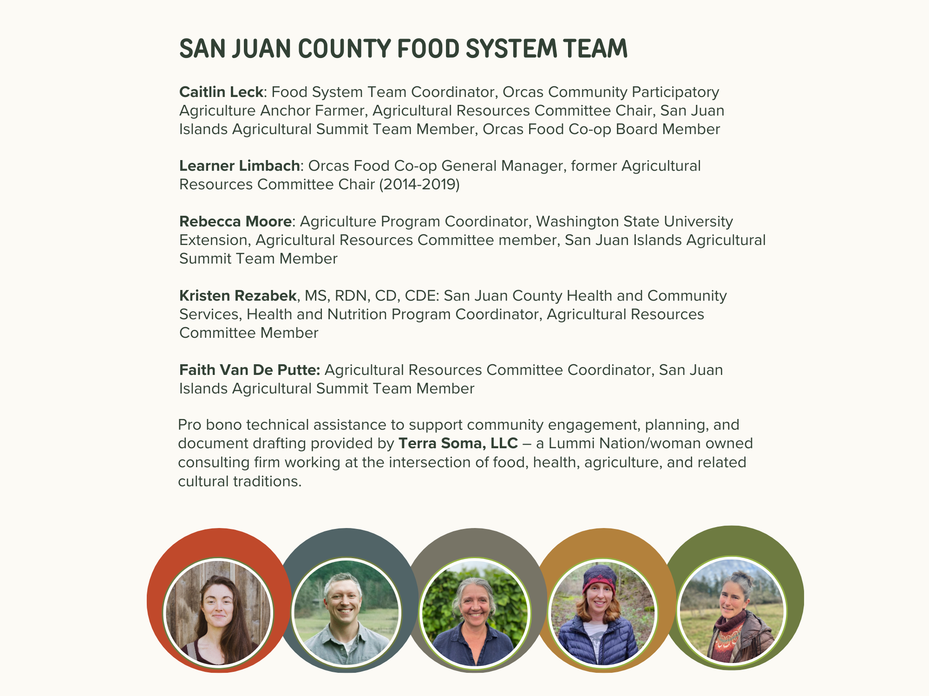
Notes:
167 FST meetings and counting!

Slide 7
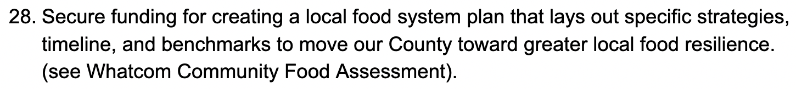
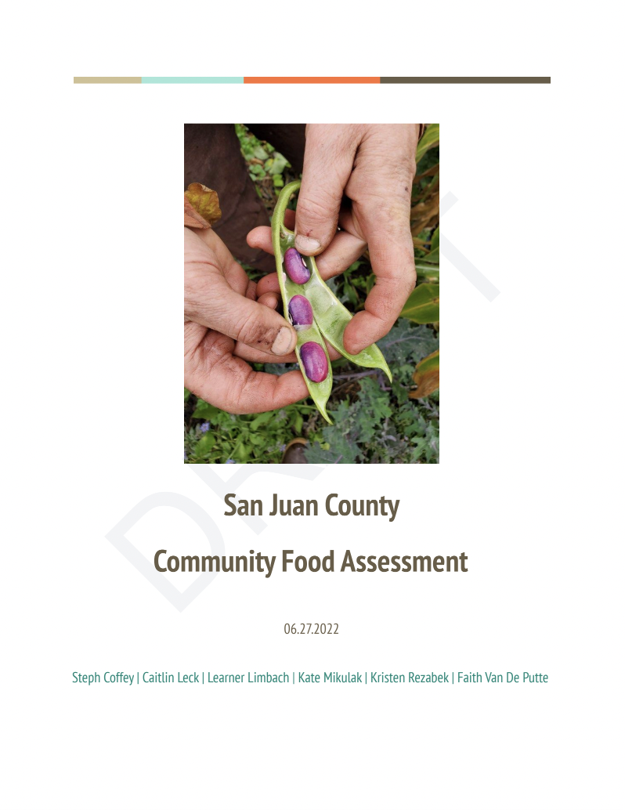
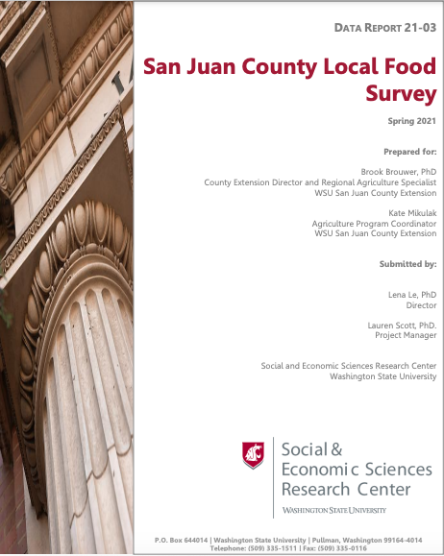
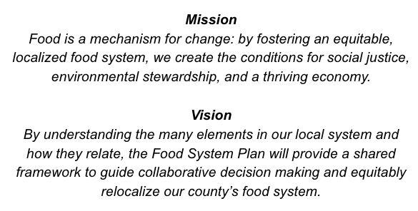
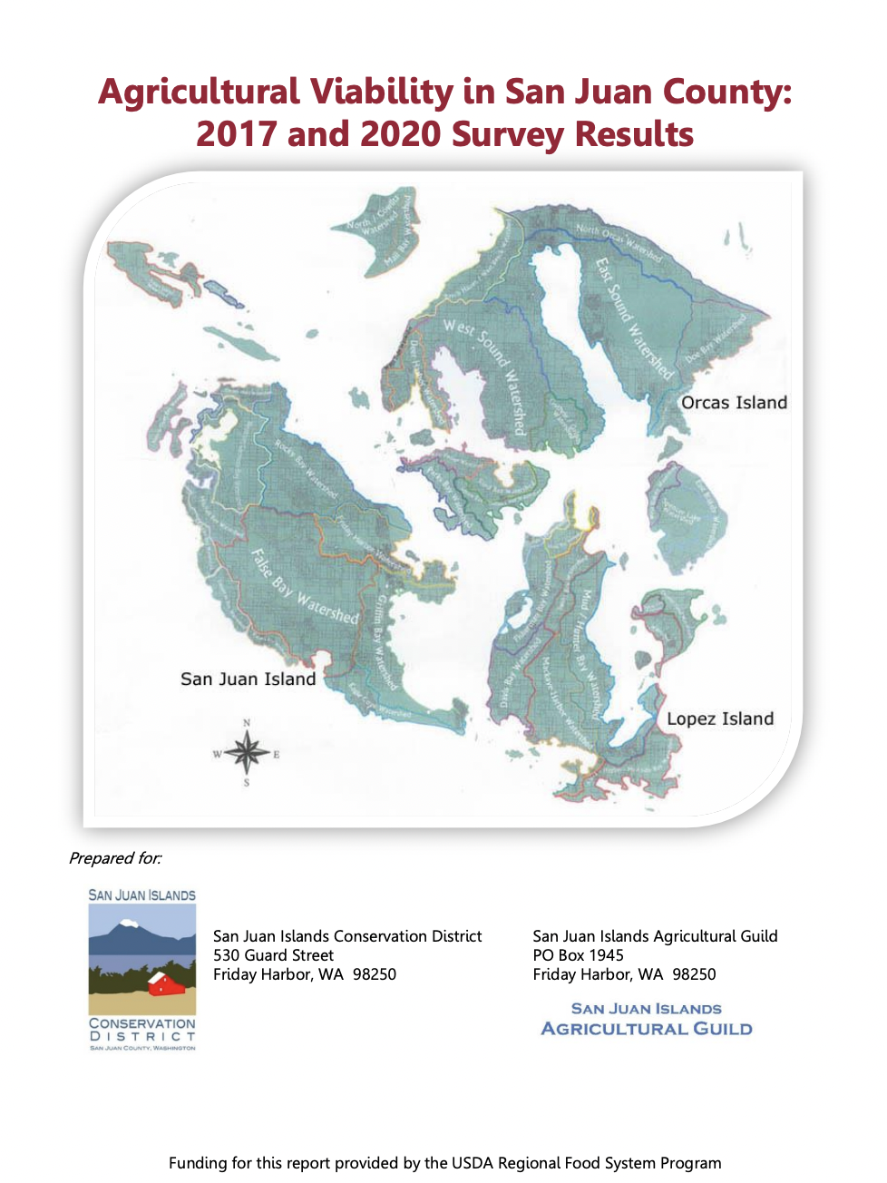
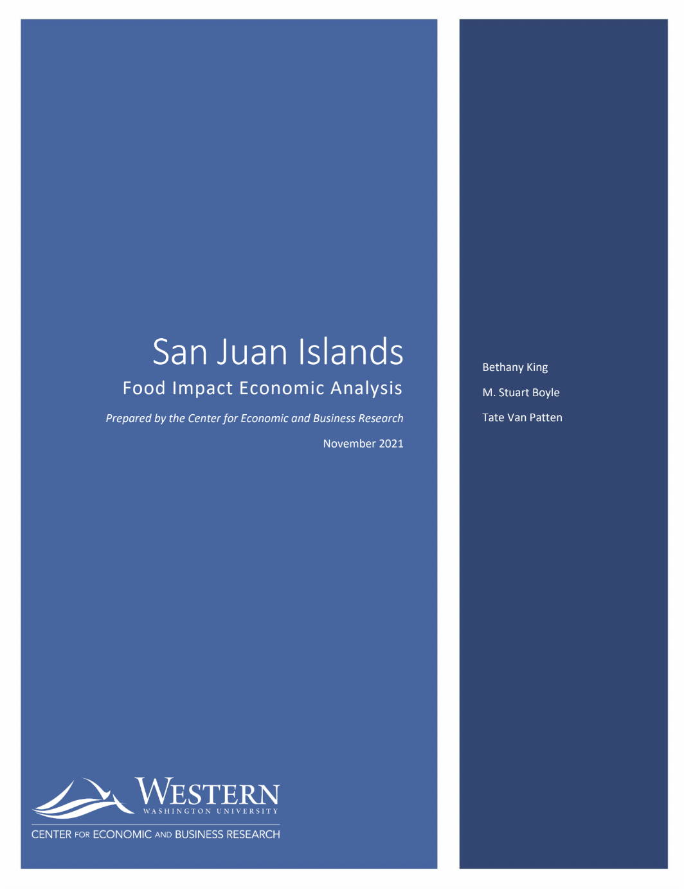
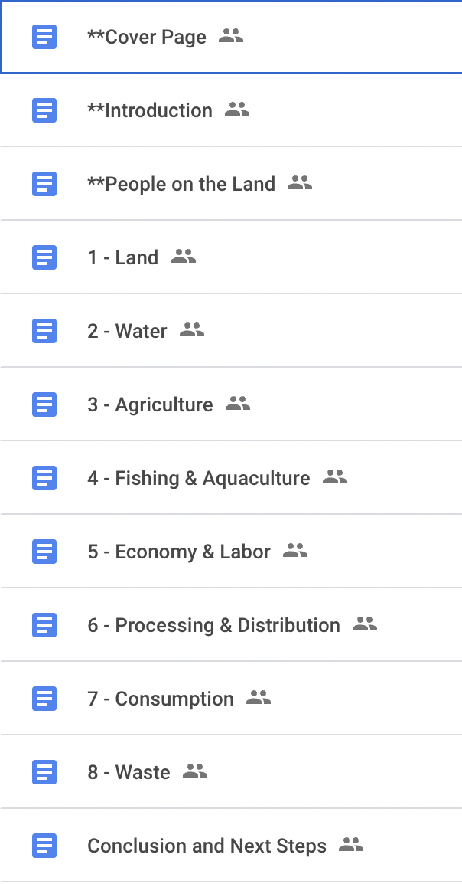
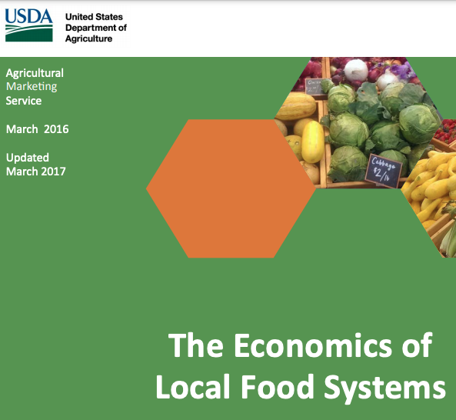
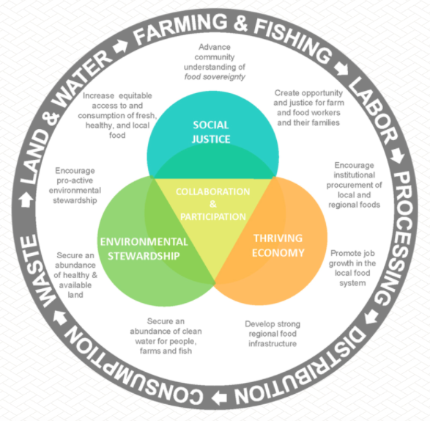
Spring 2022:
Community Food Assessment published
Fall 2020:
Data collection; RFSP grant
Fall 2019:
ARC Retreat
Winter/
Spring 2021:
Sector Snapshot drafts
Summer 2022:
Begin work on Food System Plan
Spring 2020:
Initial funding secured,
FST convenes
Summer 2020:
Secondary data deep dive
Notes:
Community Food Assessment Timeline
Fall 2019: ARC Retreat
Goal: “Secure funding for a local food system plan that lays out specific strategies, timeline, and benchmarks to move our county toward greater local food resilience”
Spring 2020: FST work begins
Private donation was initial funding that enabled FST to convene and begin the work
Pandemic emergency response work
Summer 2020: secondary data deep dive
Whatcom CFA, USDA Economics of Local Food Systems toolkit
Fall 2020: Data collection collaboration, RFSP grant
Data Collection = Collaboration of SJC Ag Orgs
Received Regional Food System Partnerships (RFSP) grant subaward
partnered with NABC, network of over 30 regional entities
$994,400 grant / $180,000 devoted to food system planning and implementation in SJC
Leveraged private donation to secure RFSP funding
enabling us to amplify efforts of Ag Orgs, hire third party studies/consultants
NABC is devoting the next three years to addressing food system infrastructure, food access, and education
Winter/Spring 2021: Sector Snapshot drafts
Spring: publish CFA
Summer 2022: begin work on FSP
Summer 2023: publish FSP

Slide 8
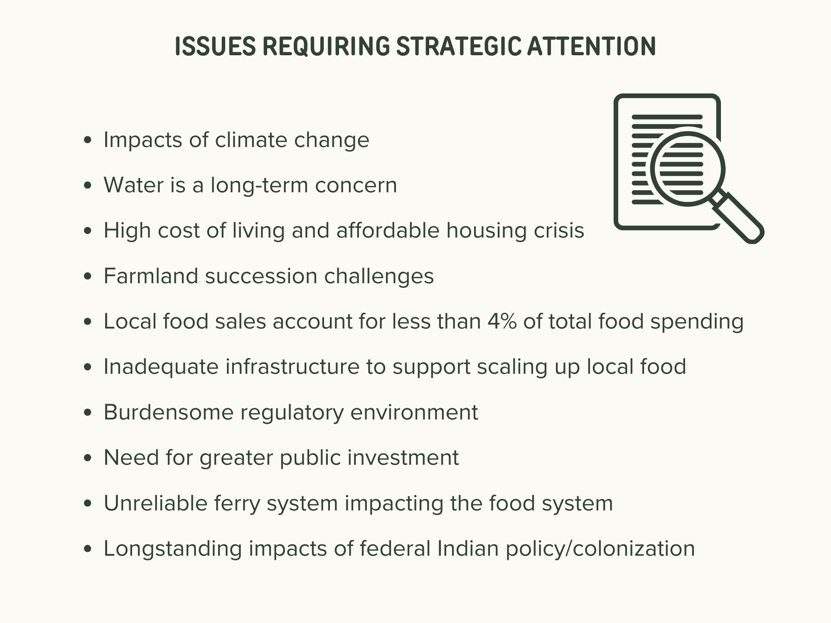
Notes:
CFA key findings: strengths and key developments + issues requiring strategic attention
Strengths
vibrant island food culture
Dedicated community of eaters who support local food
small and strong agricultural community
collaboration among supporting organizations
farmland protection and access programs
ethos of stewardship

Slide 9
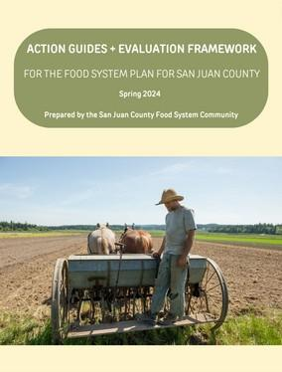
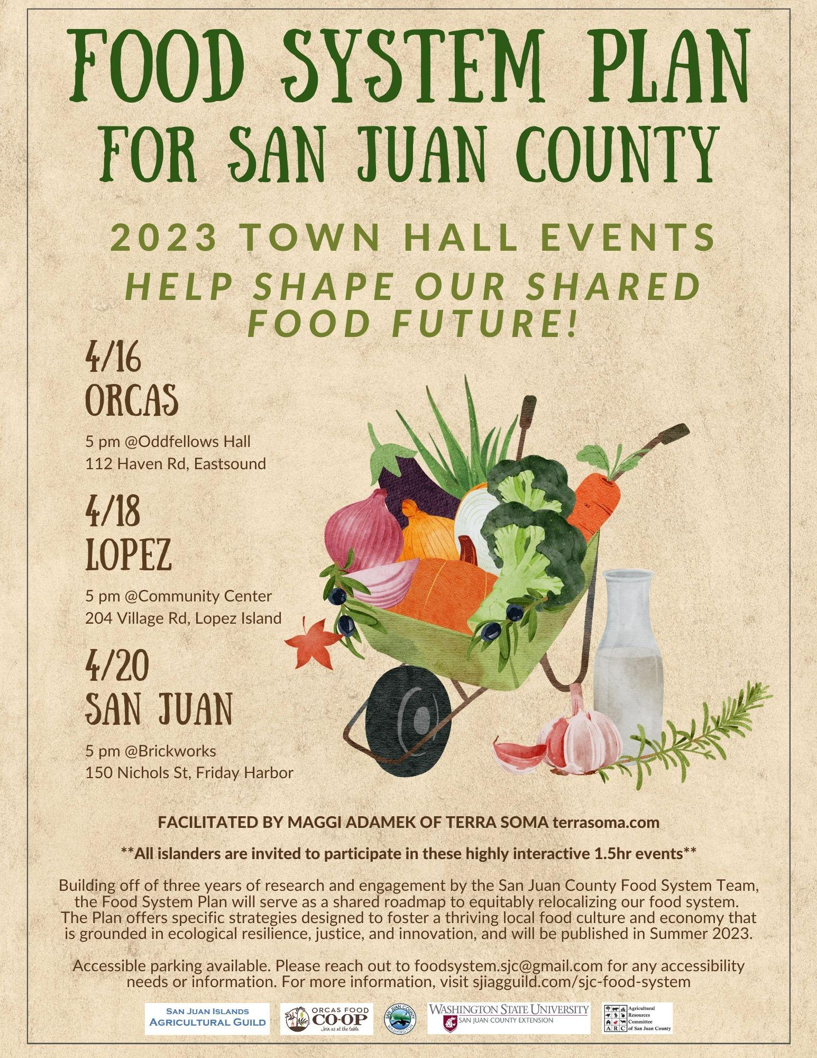

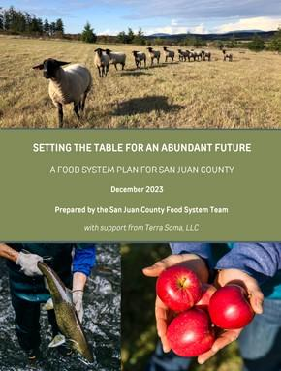
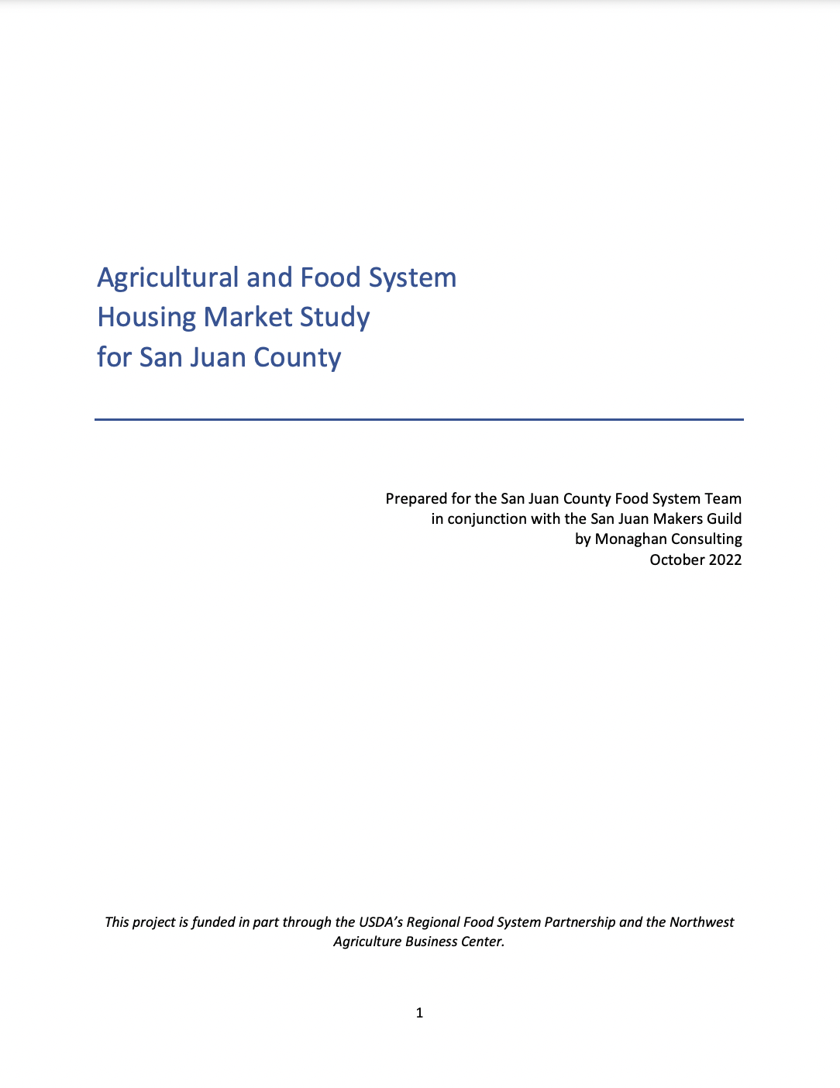
Oct-Dec 2023: FSP Peer Review + Public Comment
Winter / Spring 2024 Action Guides / Evaluation Framework
Aug 2022: RFP
Nov 2022: Strategies Spreadsheet
April 2023: Town Hall events
Oct 2022: Food System Housing Study
May 2023: co-hosted annual Agricultural Organizations Retreat
Jan 2024:
FSP Published!
Mar 2023: 1-1 interviews, focus groups
Notes:
Food System Plan Timeline
Aug 2022 RFP → Maggi!
Project design, use of budget
Stakeholder list development
Oct 2022 Housing study, etc
Nov 2022 Strategies Spreadsheet
translating the information in the community food assessment into a matrix of topics, goals and strategies.
ENORMOUS process of distillation - overwhelming → increasing clarified
Mar 2023 1-1 interviews, focus groups with 28 experts throughout SJC’s food system Spreadsheet
Dining out (restaurants)
Wholesale (Distributors - PSFH, SJFH, OFC)
Selling Food (Smaller/farmers markets + retailers
Basic needs (Food access + hunger relief advocates/programs)
Serving Farmers (Ag organizations + Producers)
Food service (schools, senior meals, camps, FH labs)
April 2023 3 community Town Hall events, to incorporate community feedback and priorities into the Food System Plan; engaged with 150+ islanders
Flier
Town Hall Events photos
May 2023 co-hosted annual Agricultural Organizations Retreat, to incorporate organization reps’ feedback on the Food System Plan and begin to delineate priorities and necessary action steps; 30 people in attendance representing 20 ag- and food-related organizations
Agricultural Organizations Retreat photos
“Who is Doing What” document
Oct 2023 Peer review of draft Food System Plan
Dec 2023 Public comment for final round of feedback on Food System Plan report
Jan 2024 FSP Published
Winter / Spring 2024 Action Guides / Evaluation Framework

Slide 10
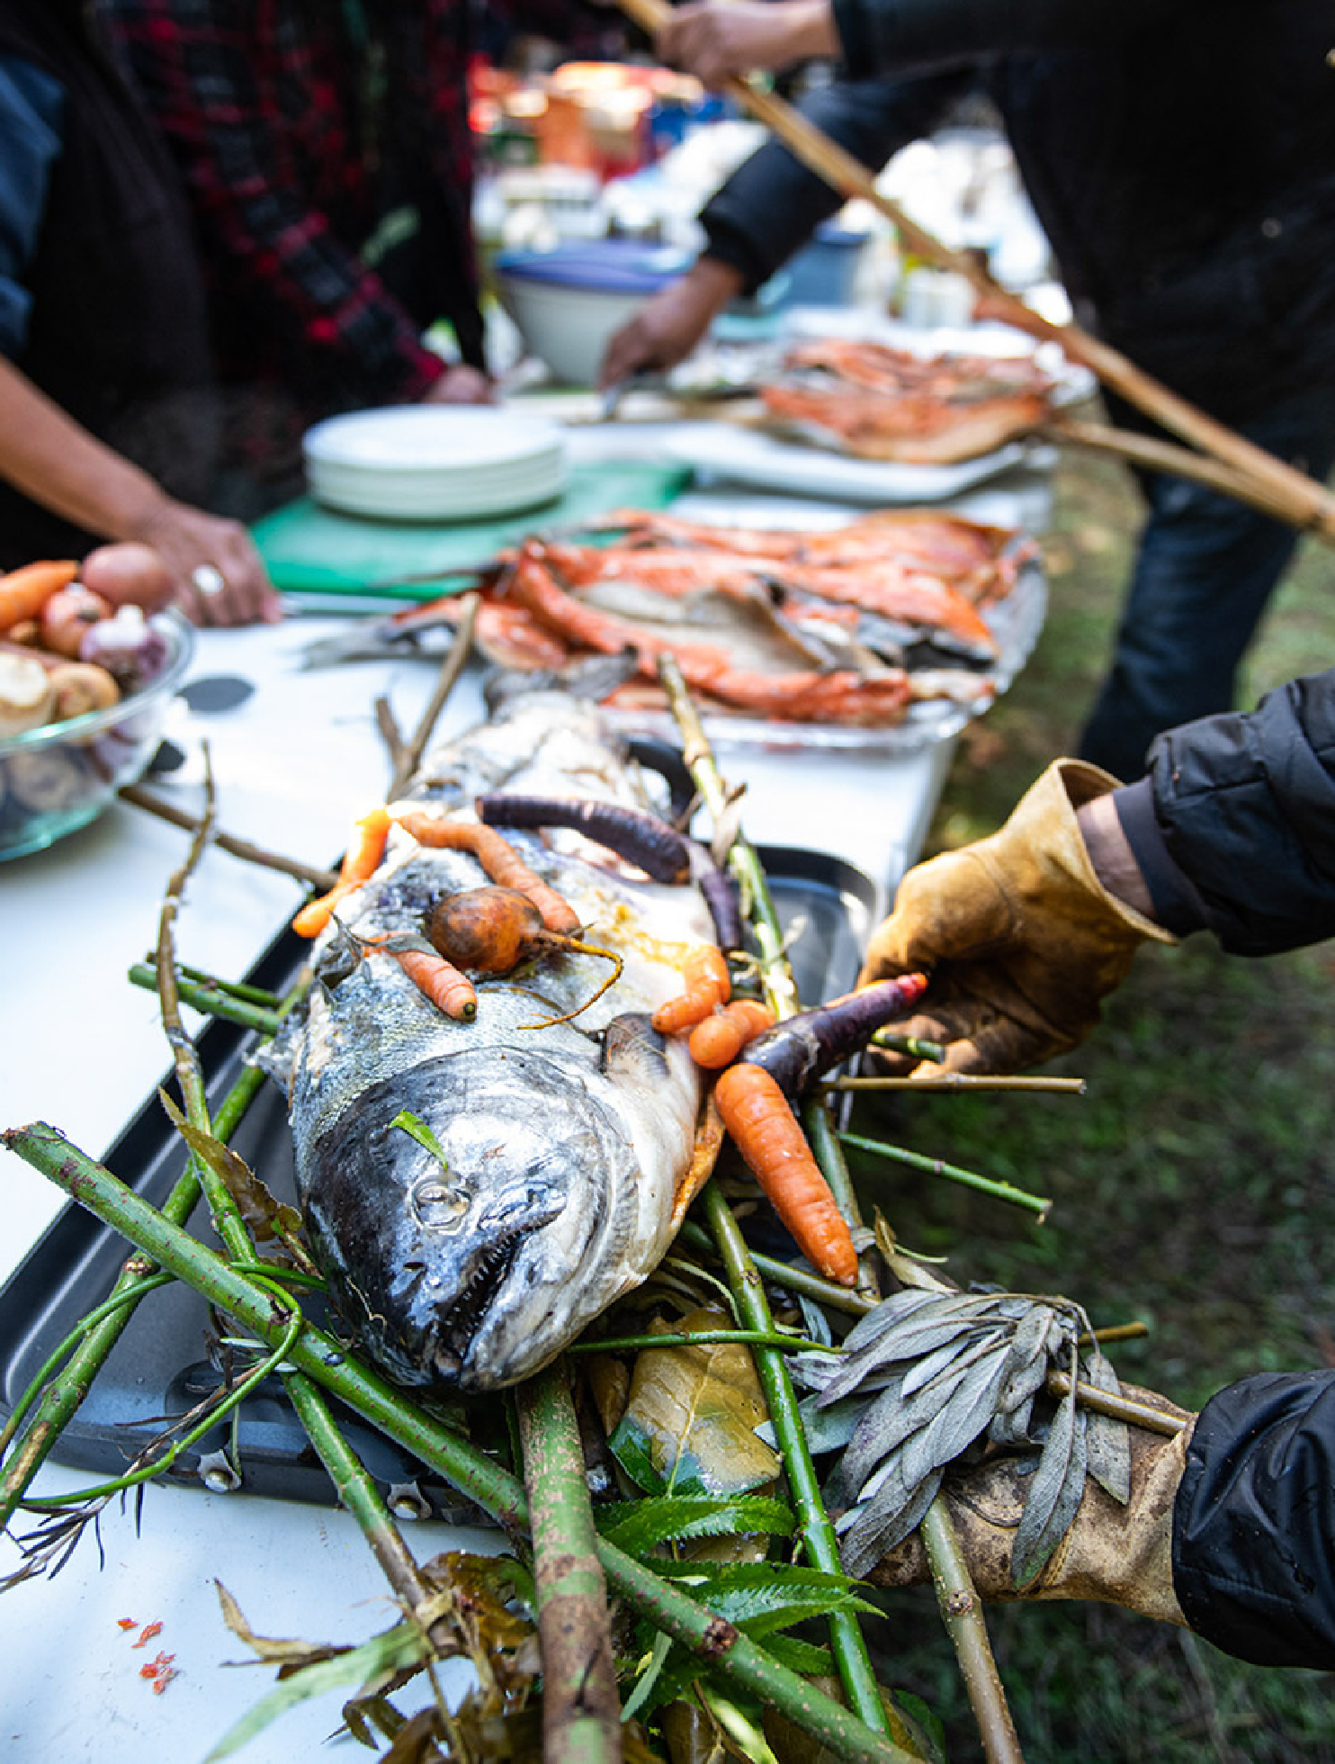
Ongoing:
Building connections with Coast Salish food sovereignty leaders and Elders
  Two approaches for relationship building
Presentations
  SJC Council
  Ag/food events
  Community events
Monthly food system planner meetings with colleagues from Whatcom, Island, and Skagit Counties
Image: Salmon Pit Cook, by Tallulah
Notes:
Presentations
SJC Fair
Waldron CLT
Ag Org Retreat
SJC Council
Ag Summit
Listening Sessions
Regional planner meetings
build regional connections, share best practices, and investigate collaboration opportunities

Slide 11
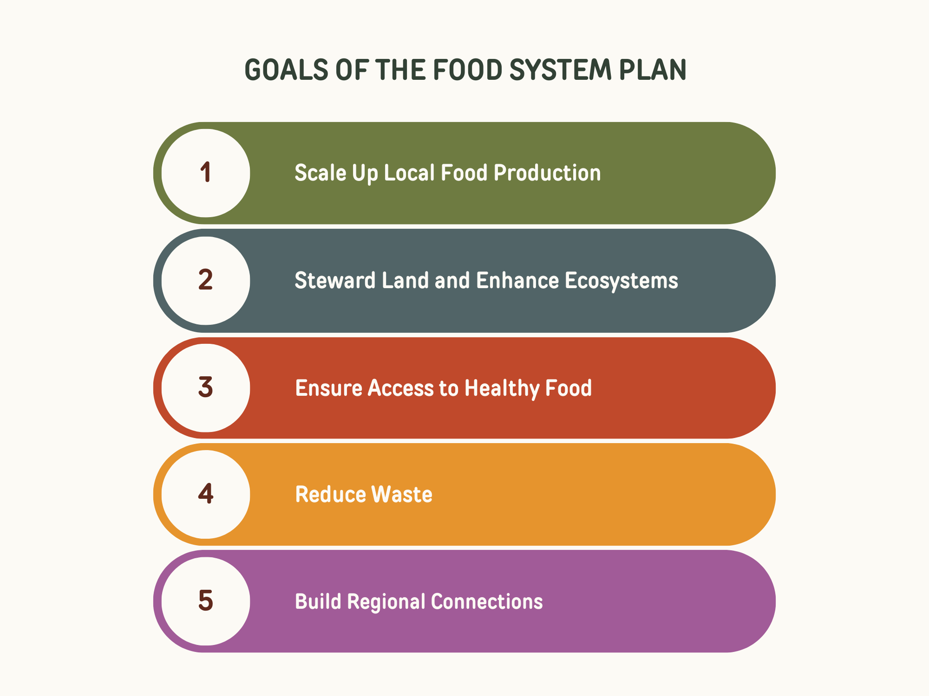

Slide 12
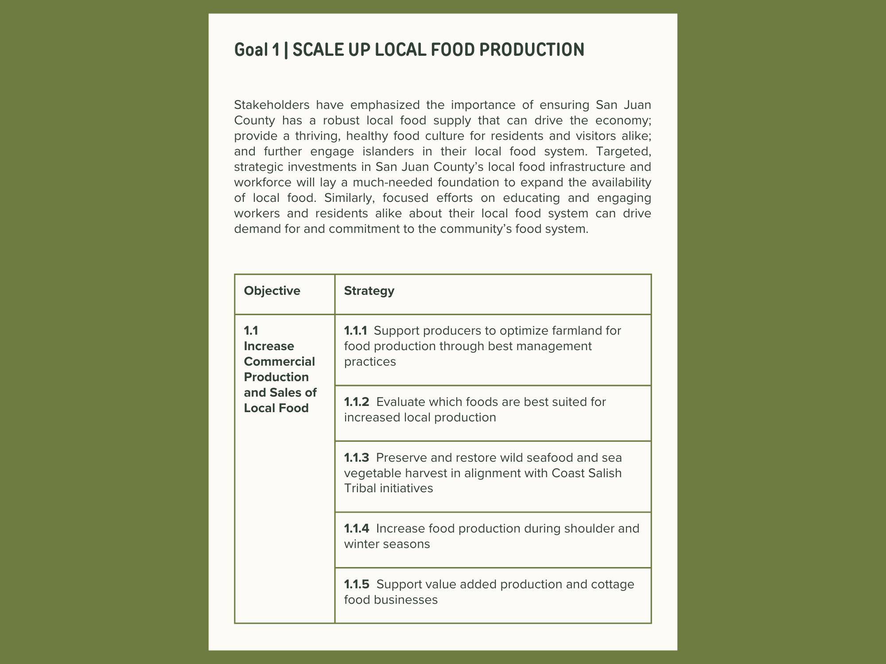

Slide 13
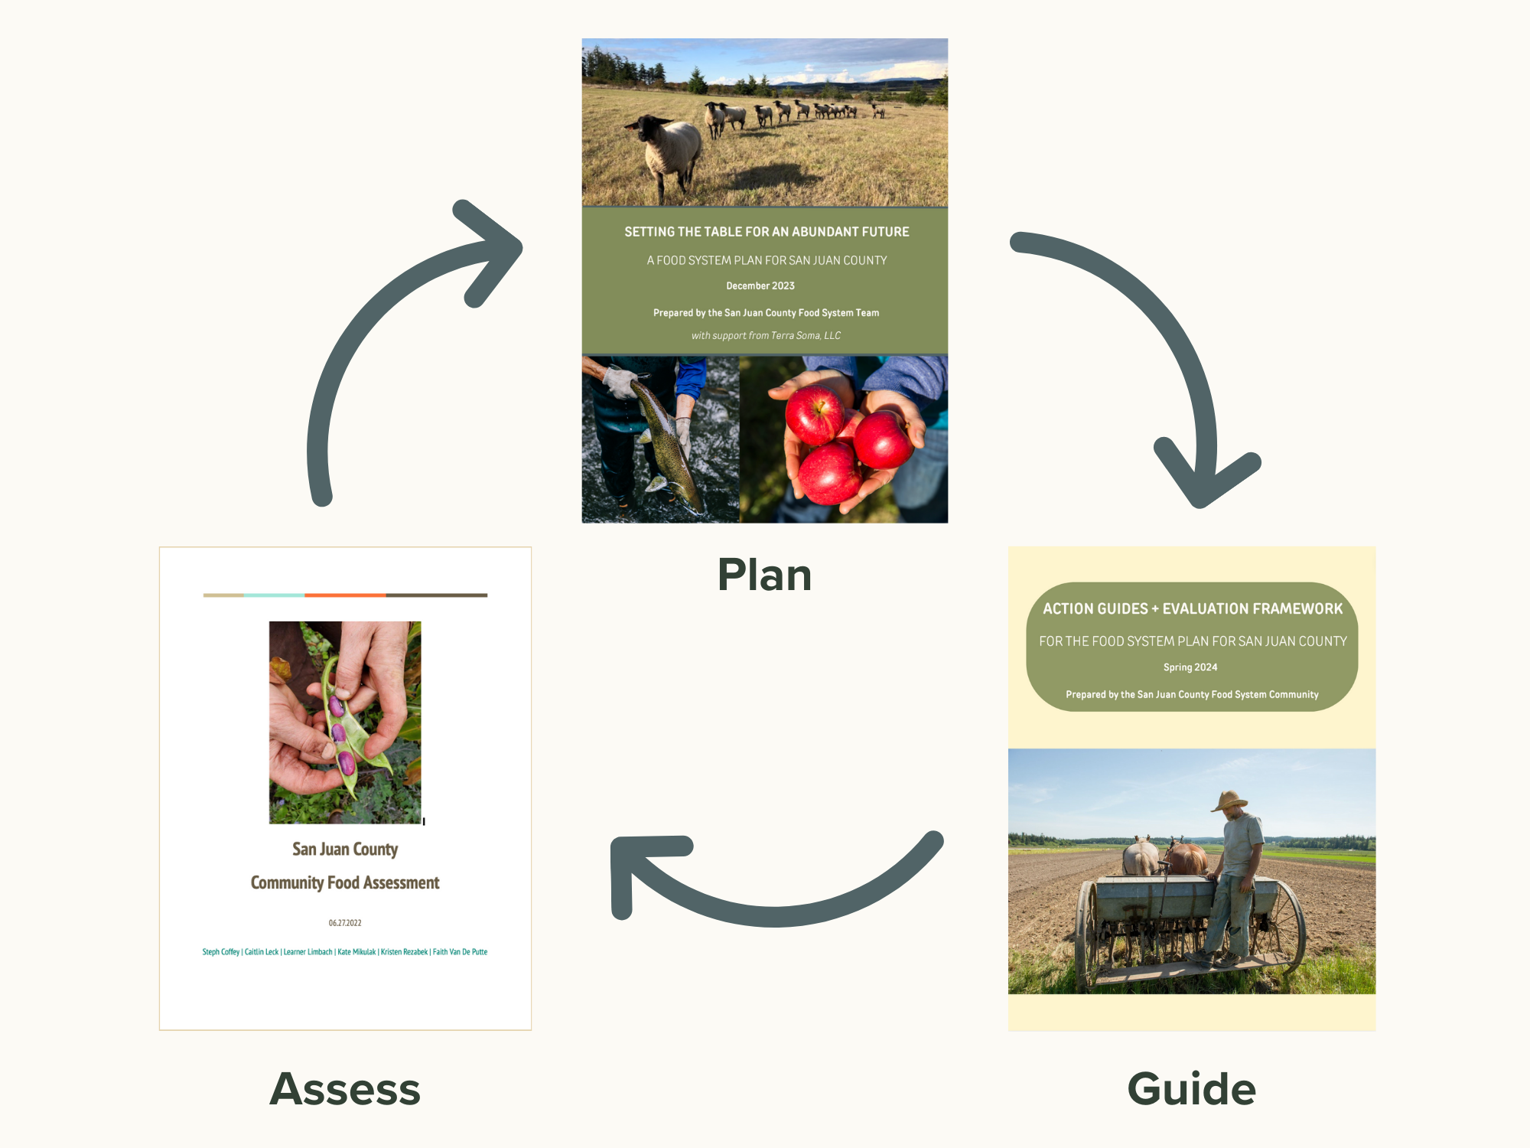

Slide 14
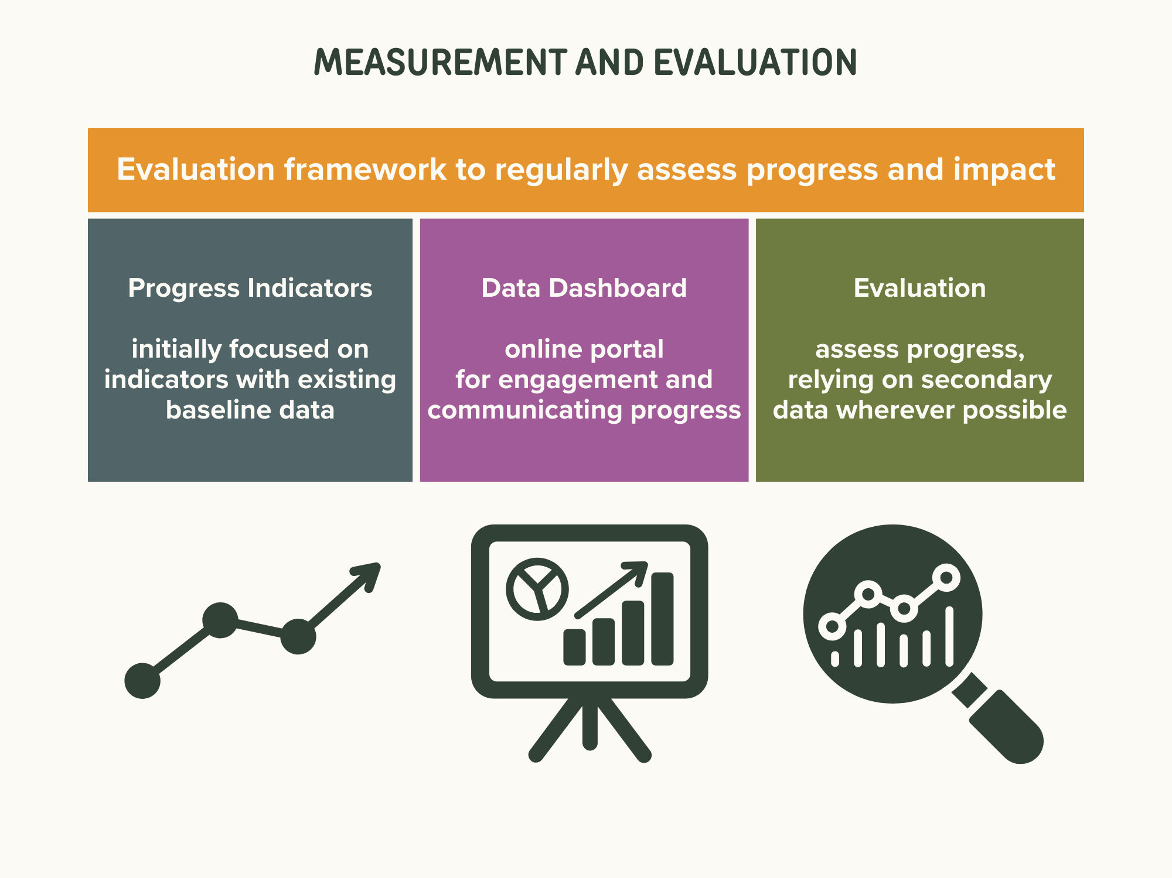
Notes:
Identify progress indicators > develop data dashboard > ongoing evaluation
In developing the Data Dashboard:
Secondary data whenever possible, and filling in with primary data only when it meets a specific need
Another consideration is wanting to make it user friendly and accessible for people in the Ag world, decision-makers and the general public, AND for whoever has to update it.
one of our RFSP grant objectives
Interest in teaming up regionally to streamline and strengthen the dashboard as a resource

Slide 15
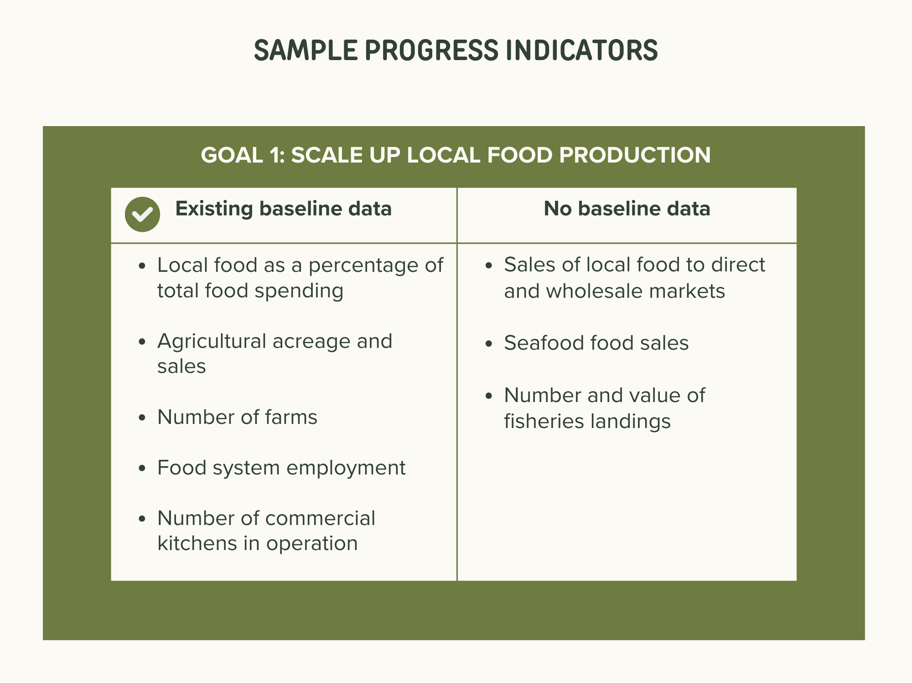
Notes:
As we’ve gone through creating the plan, progress indicators have been identified for each goal
We’re now working on refining those lists
One step in that process is organizing them by ones we have baseline data for and ones that we don’t
Some have existing baseline data and some do not
Secondary data wherever possible

Slide 16
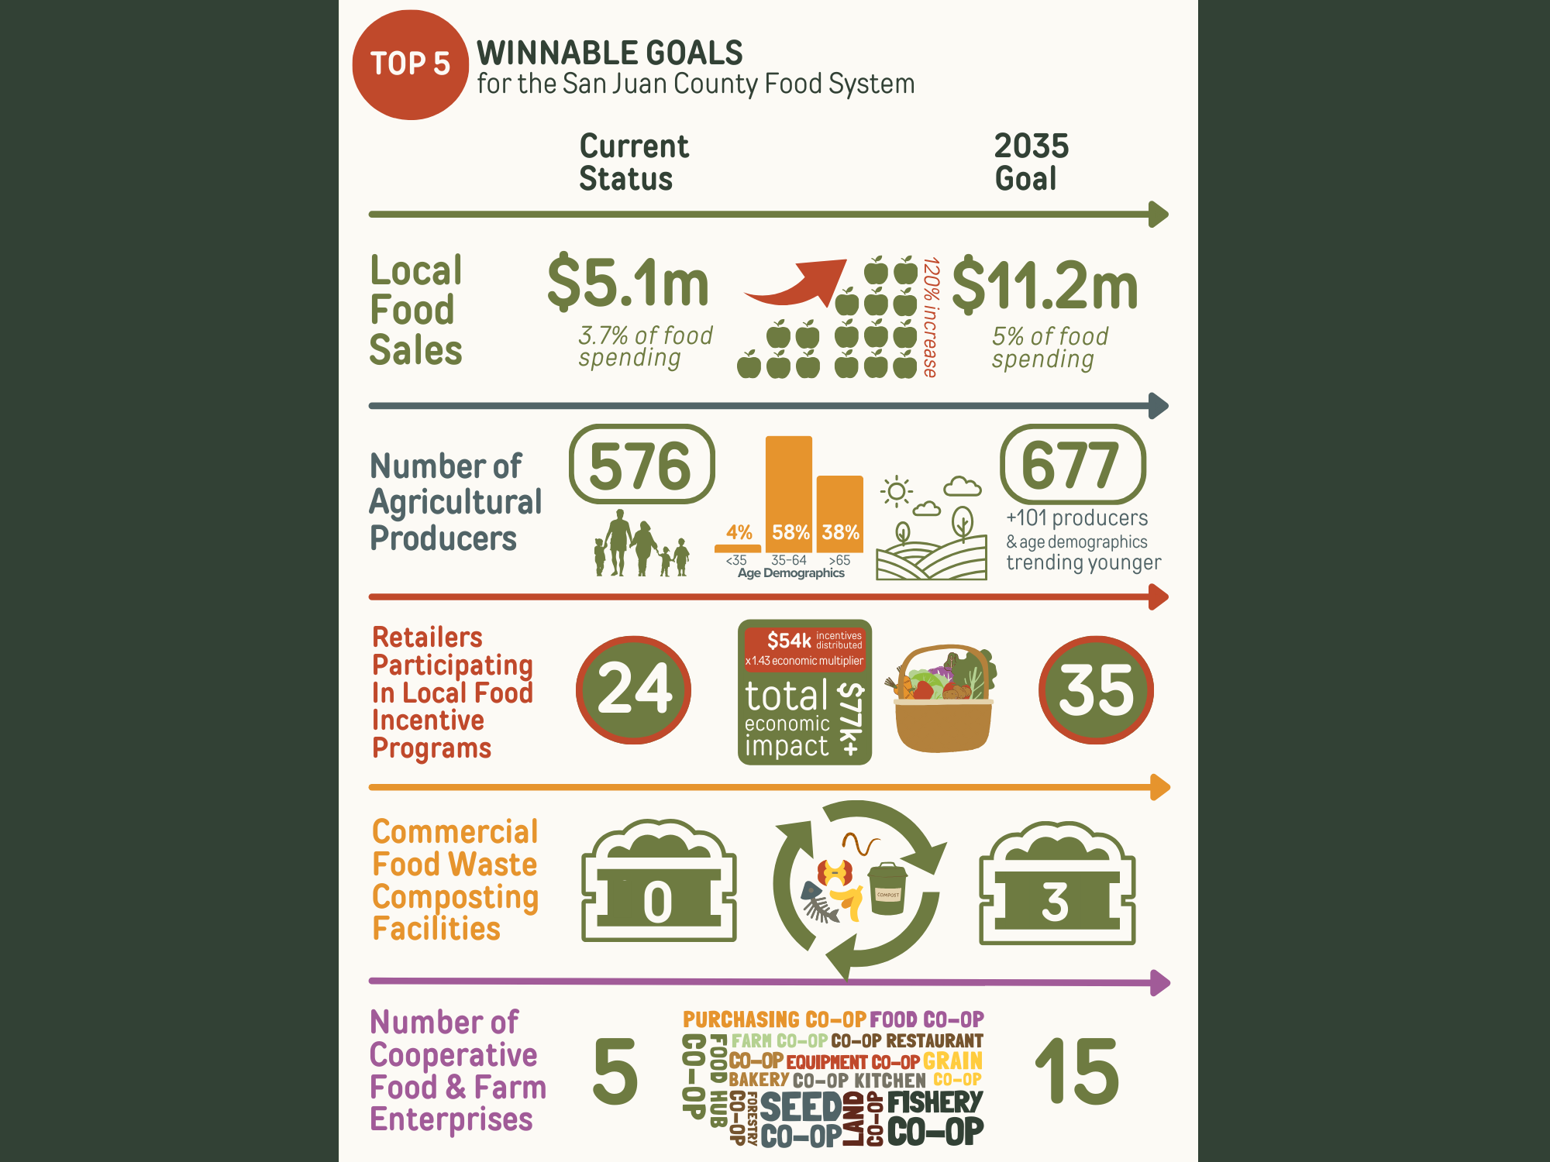
Top 5 infographic

Slide 17
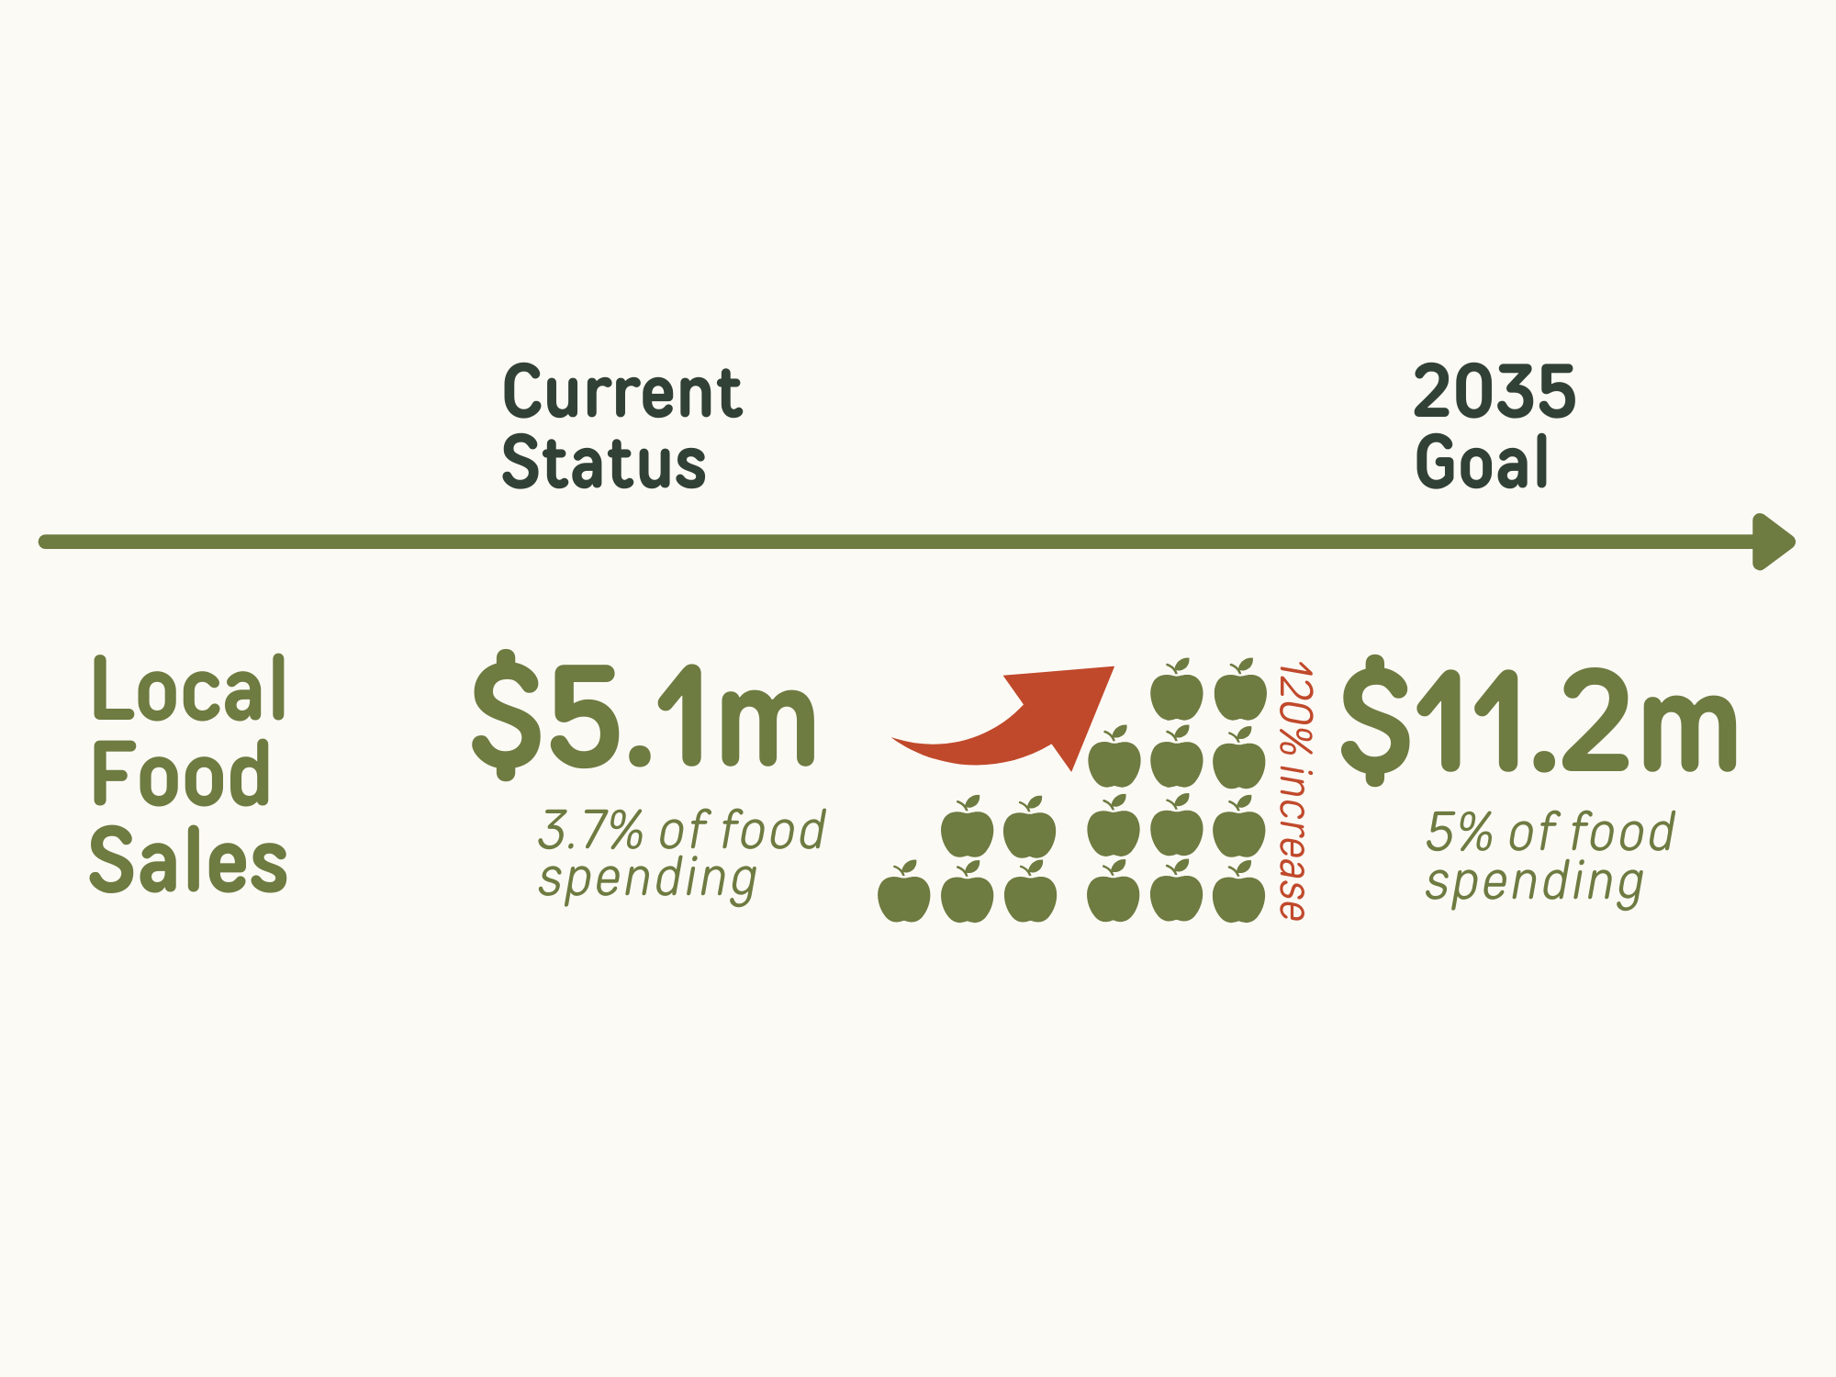

Slide 18
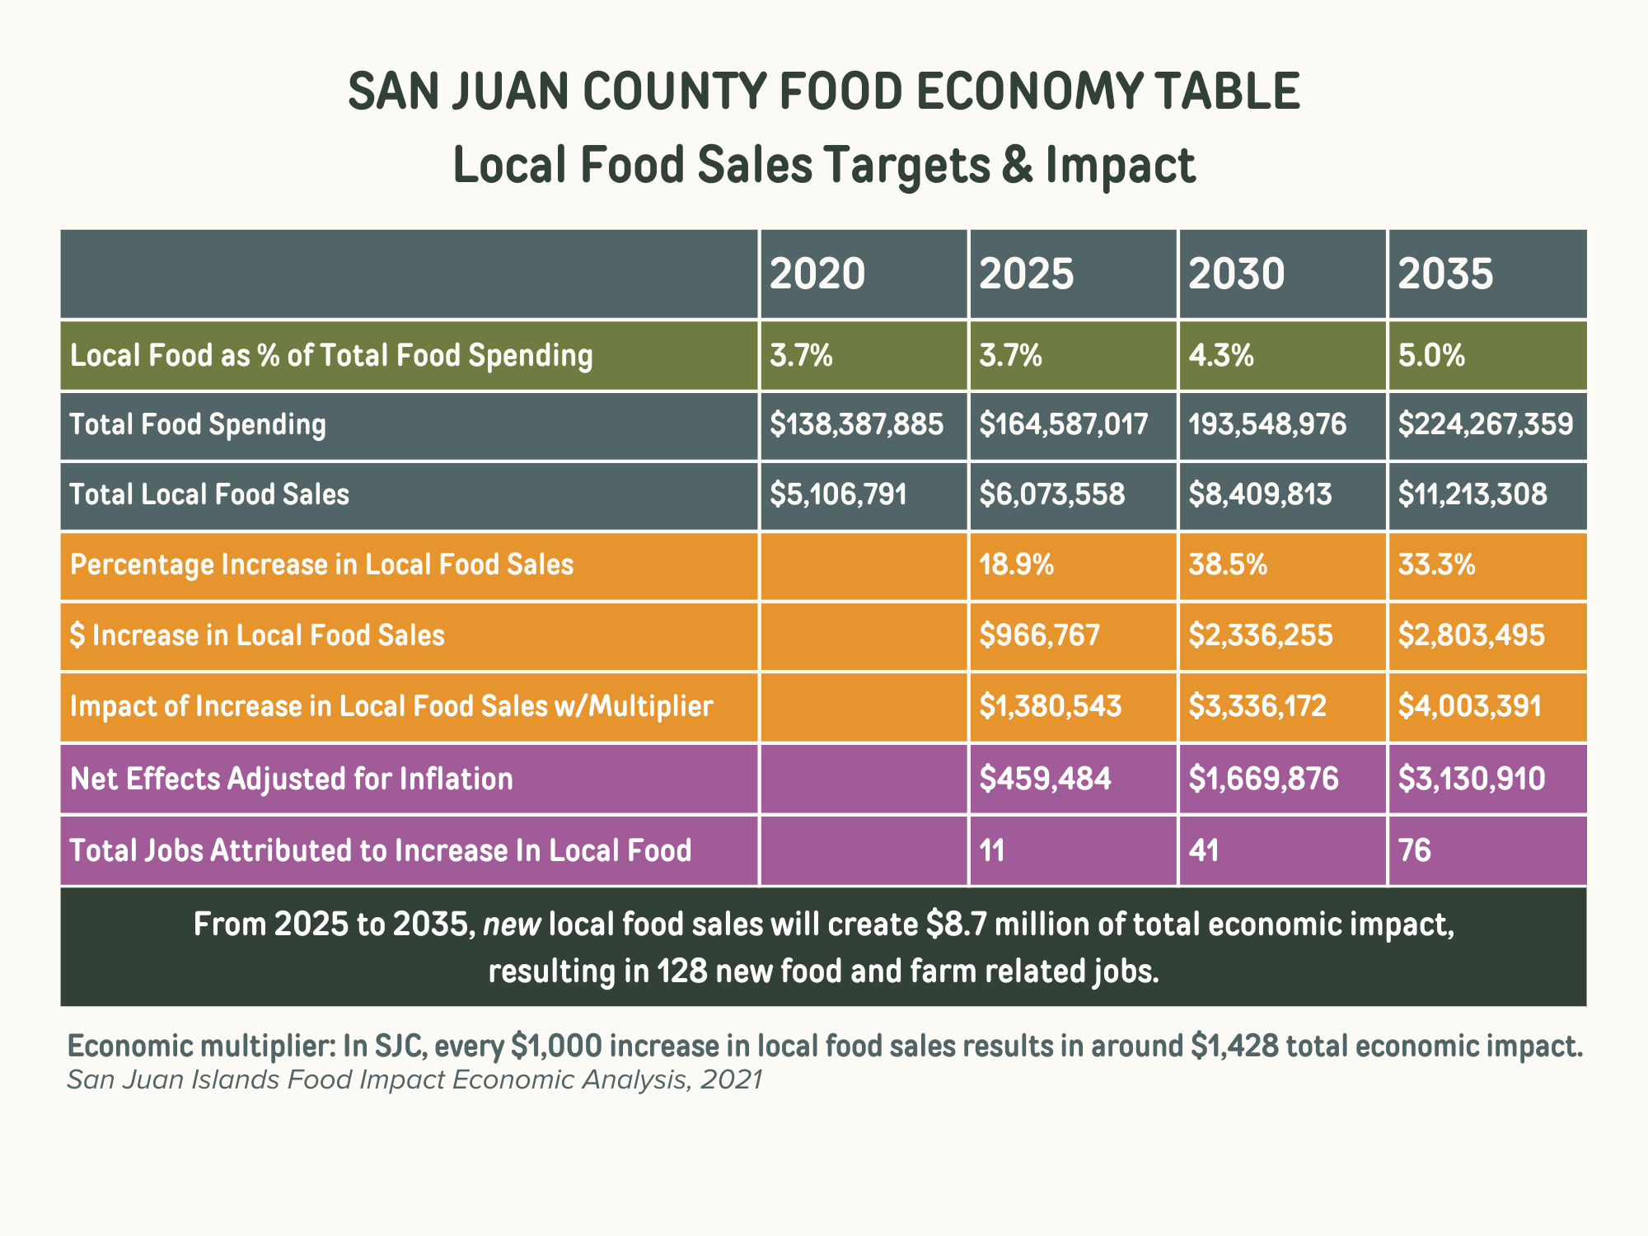
Notes:
Developed this tool that allows us to envision different scenarios
Project the total economic effects of various changes in local food production and sales
To be able to create compelling stories of our vision for the future for policy-makers, funders, and producers, eaters, and other stakeholders
Strategic planning > “you can’t manage what you can’t measure”
That’s a glimpse into our process, findings and vision, and we welcome your feedback and questions. Thank you!

Slide 19
Be in touch!
https://sjiagguild.com/sjc-food-system/
Maggi Adamek madamek@terrasoma.com
Caitlin Leck foodsystem.sjc@gmail.com
Learner Limbach learner@orcasfood.coop

