Slide 1
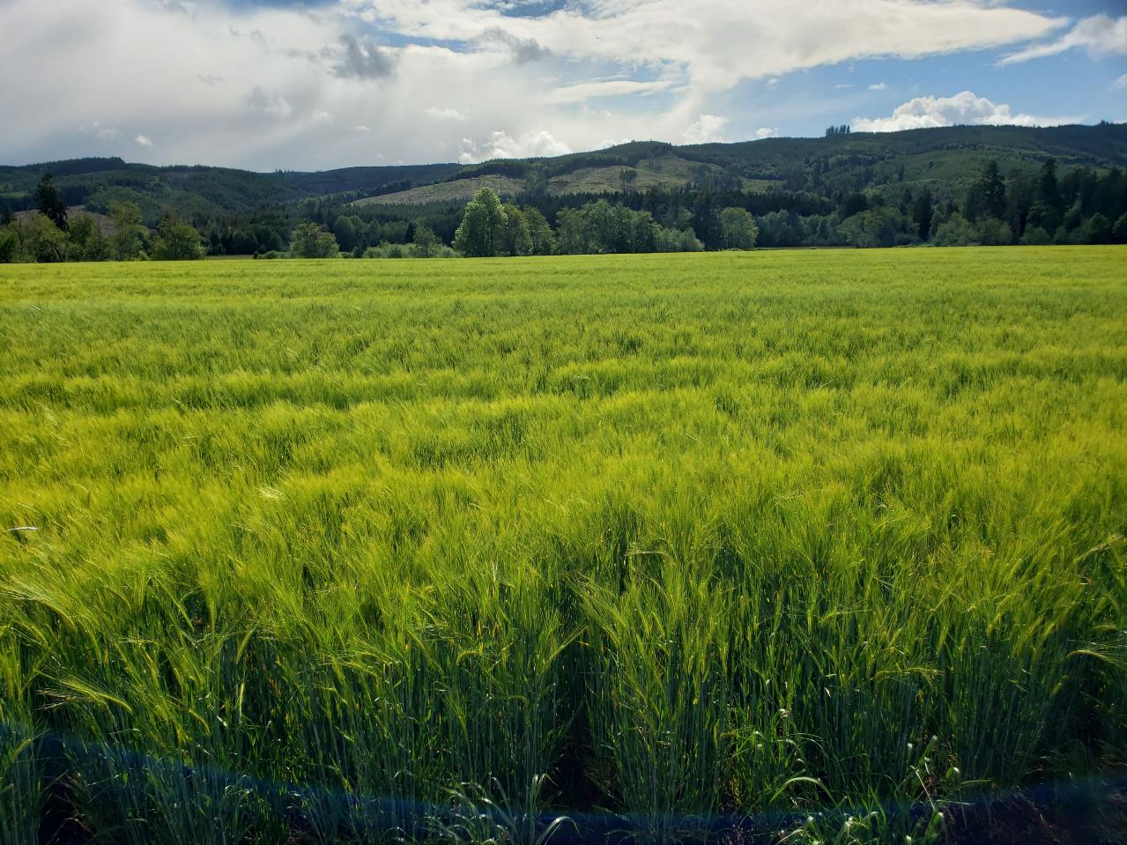
HISTORY
Flood Events
Marketing Challenges
National Frozen Foods
Symons Frozen Foods

Slide 2
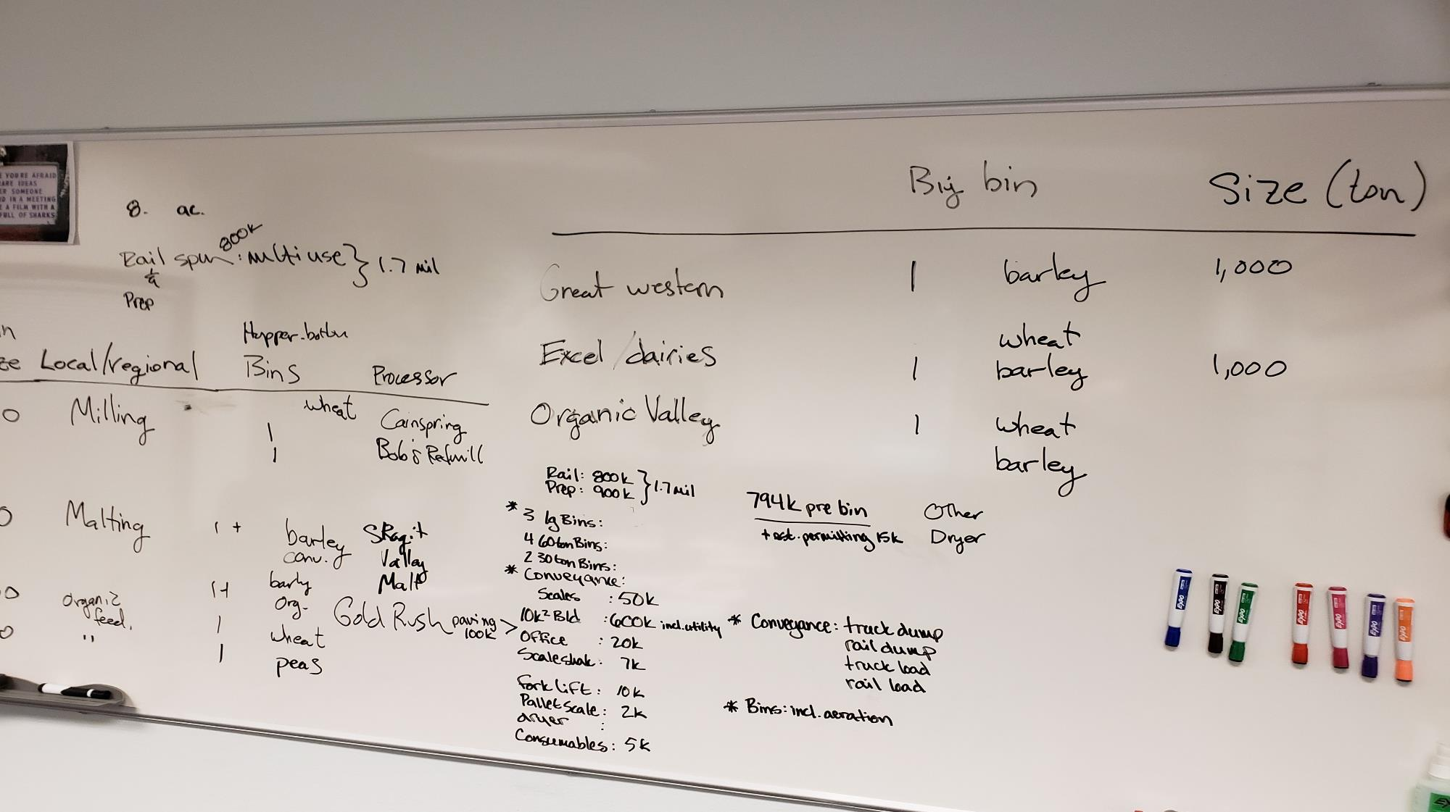

Slide 3

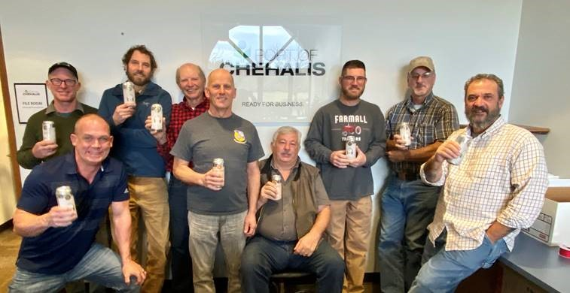
Farmer-Owned Cooperative
Incorporated December 2019
37 members from 6 Counties
Includes SW WA Food Hub
“Increase the viability of Southwest Washington Family Farms through collaborative opportunities
in marketing, logistics, and stewardship.”

Slide 4

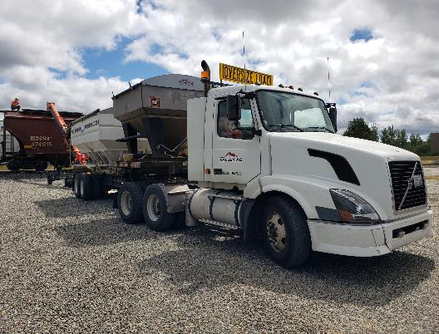
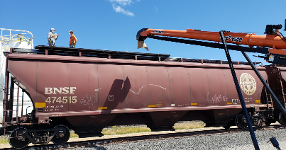
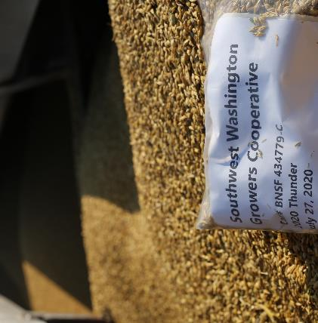
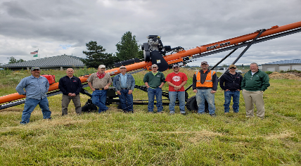
PARTNERSHIP
  WSU
  OSU
  NABC
  Great Western Malting
  Port of Chehalis
  Talking Cedar Brewing
  SW WA Growers Co-op
  Valley Agronomics

Slide 5
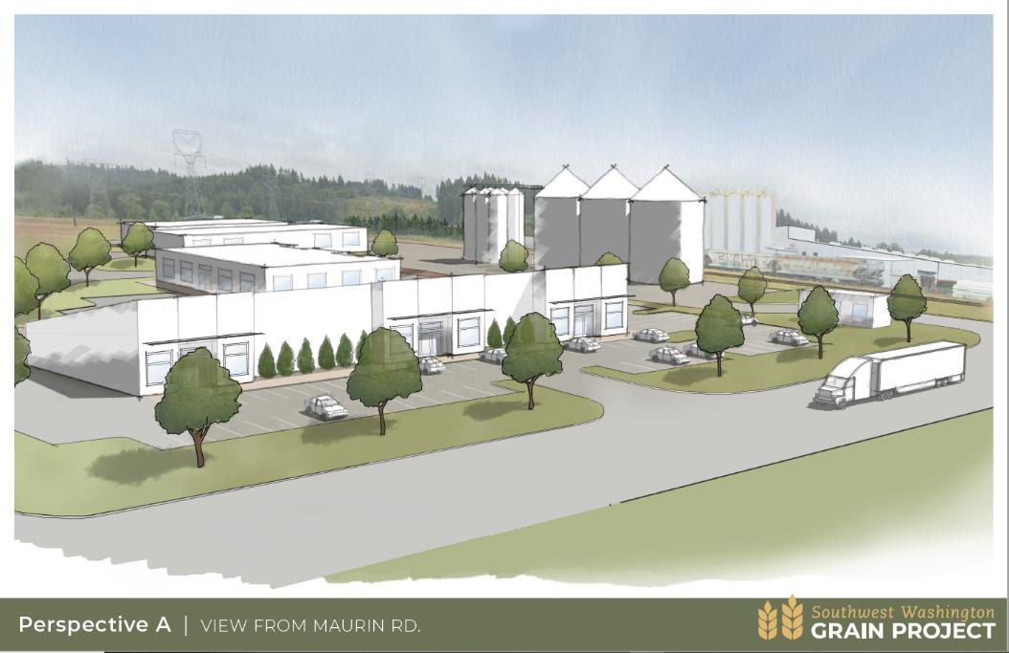
Port of Chehalis Property
$800k Distressed Counties Funds
RBDG Grant for Comprehensive Site Plan: $32k
RBDG for phased construction plan, Geological Survey, and Engineers’ Report: $6.2k
Grain Facility Phase 1 funded through Capital Budget Request
RCDG for continued support: $51k
EDA CARES Grant $4.5M
HUD Funding $4.1M

Slide 6
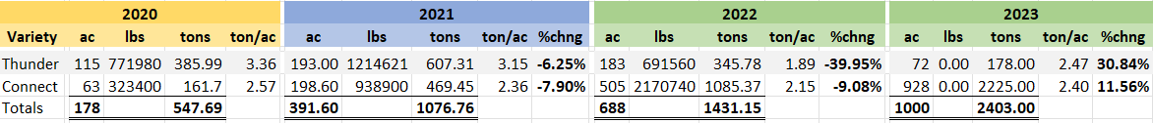

Slide 8
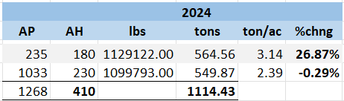

Slide 9
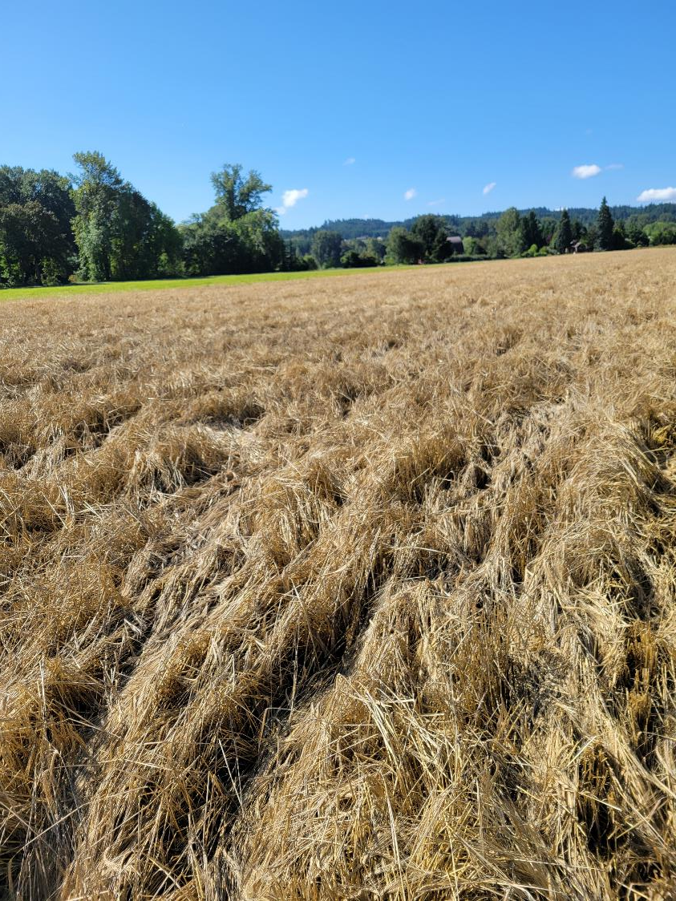
August Rain
  Olympia recorded 1.38 inches
  Some areas recorded more than 2 inches!

Slide 10
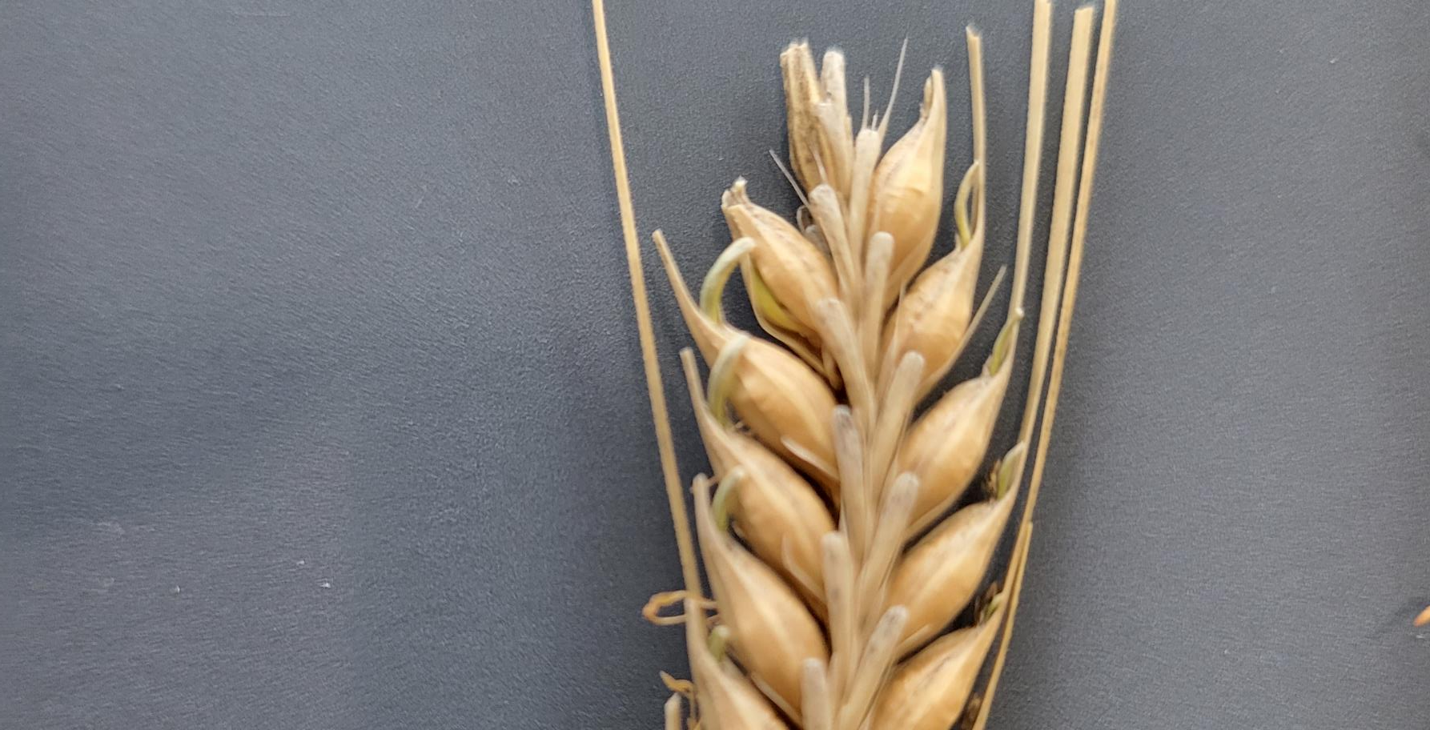

Slide 11
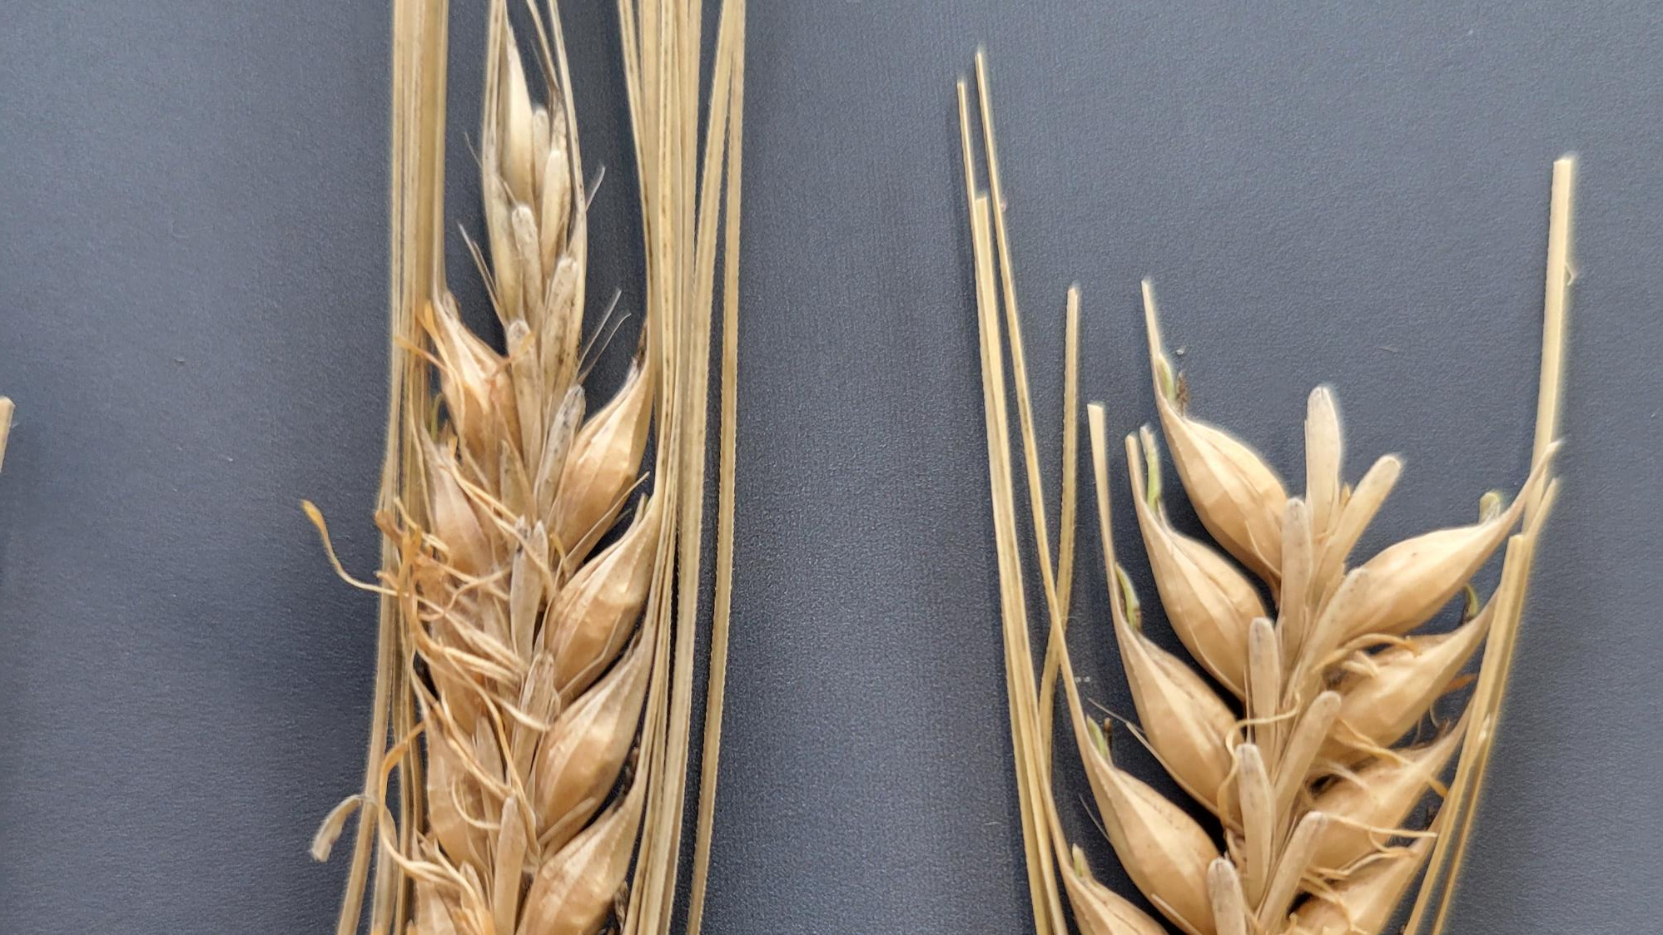

Slide 12
Variety | Acres Planted | Acres Damaged/Lost | Acres Harvested | Revenue Lost | Revenue Recovered?
Connect | 1033 | 858 | 230 | $471,642 | $300K (+) or (-)
Thunder | 235 | 55 | 180 | $39,721 | $0

Slide 14
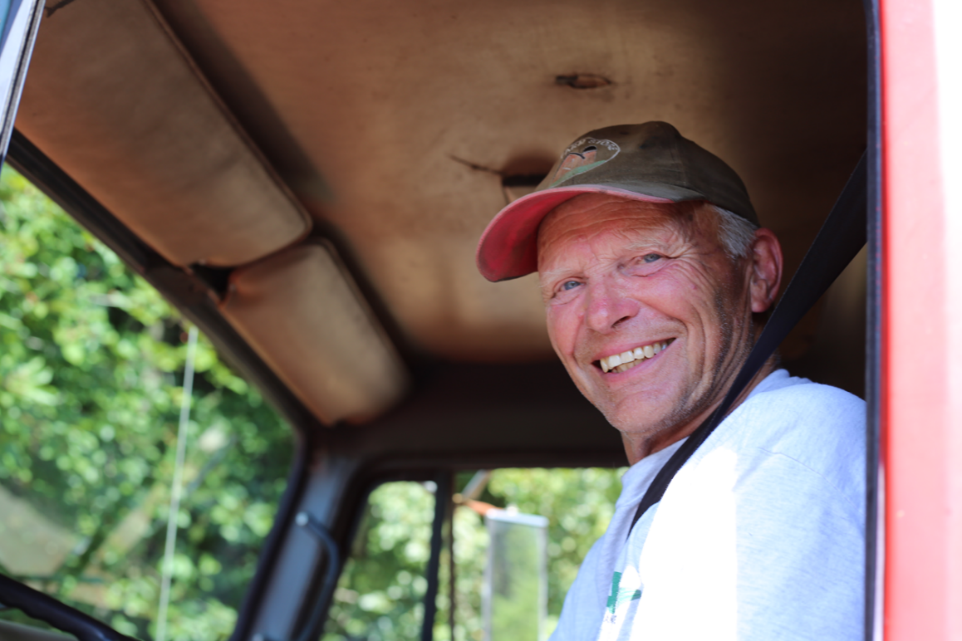
Path Forward Regional Grain
Recent Funding
  EDA CARES Grant
  Community Funded Projects (HUD)
Source Additional Capital
  Membership
  Other
Current Markets
  Malting Barley
  Distilleries
  Feed Mills
  Seed Crops
Access new markets
  Identity preservation
  Local brewers/distillers
  Additional products

Slide 15
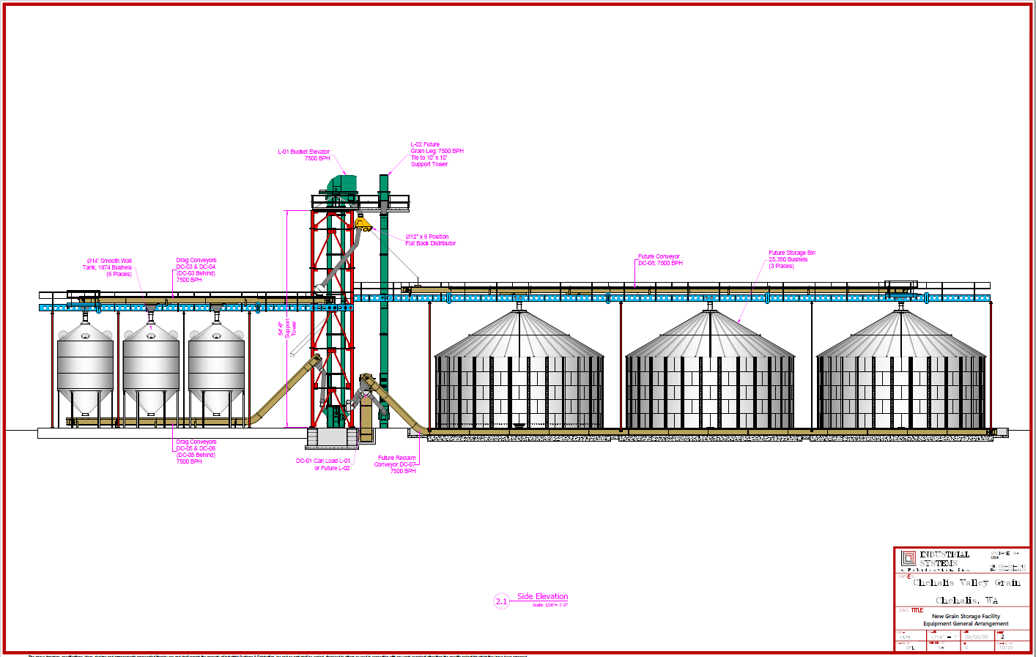
Opportunity
Wheat, barley, oats, peas
Storage & Cleaning
Incoming and outgoing
Access to new markets
Insulation from volatility
Identity preservation
Benefit to: Farmers, Ranchers, Dairy, Poultry, Baking, Brewing, Distilling…

Slide 16
Questions

